Slide 1
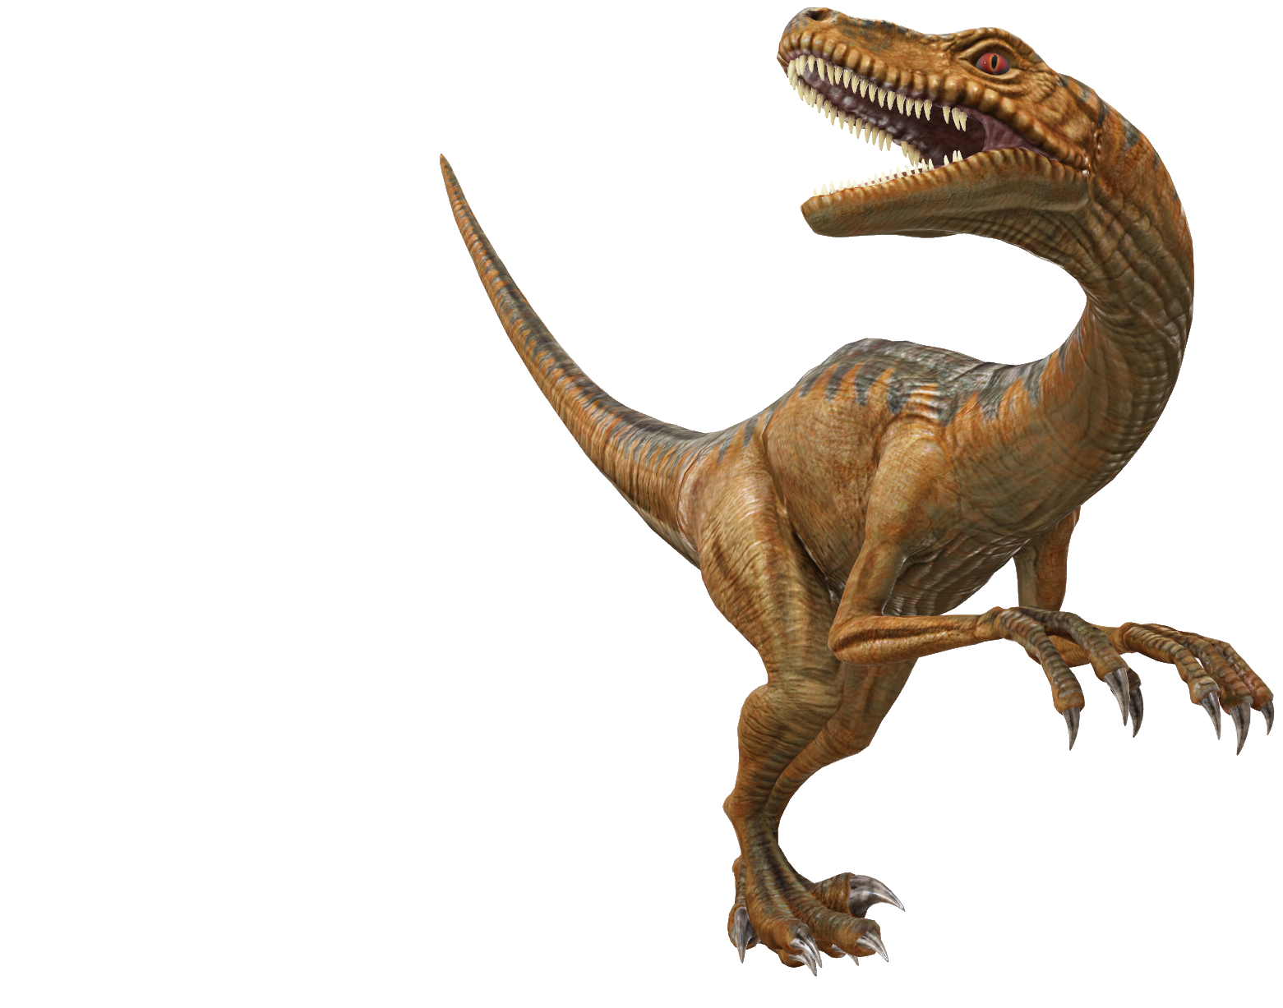
Unsupervised Graph Network Discrimination
CSE499A.5
Faculty: Mohammad Ashrafuzzaman Khan (Azk)
Done by:
Mahmud Elahi Akhter (1721498042)
Zahin Ahmed (1711020042)

Slide 2
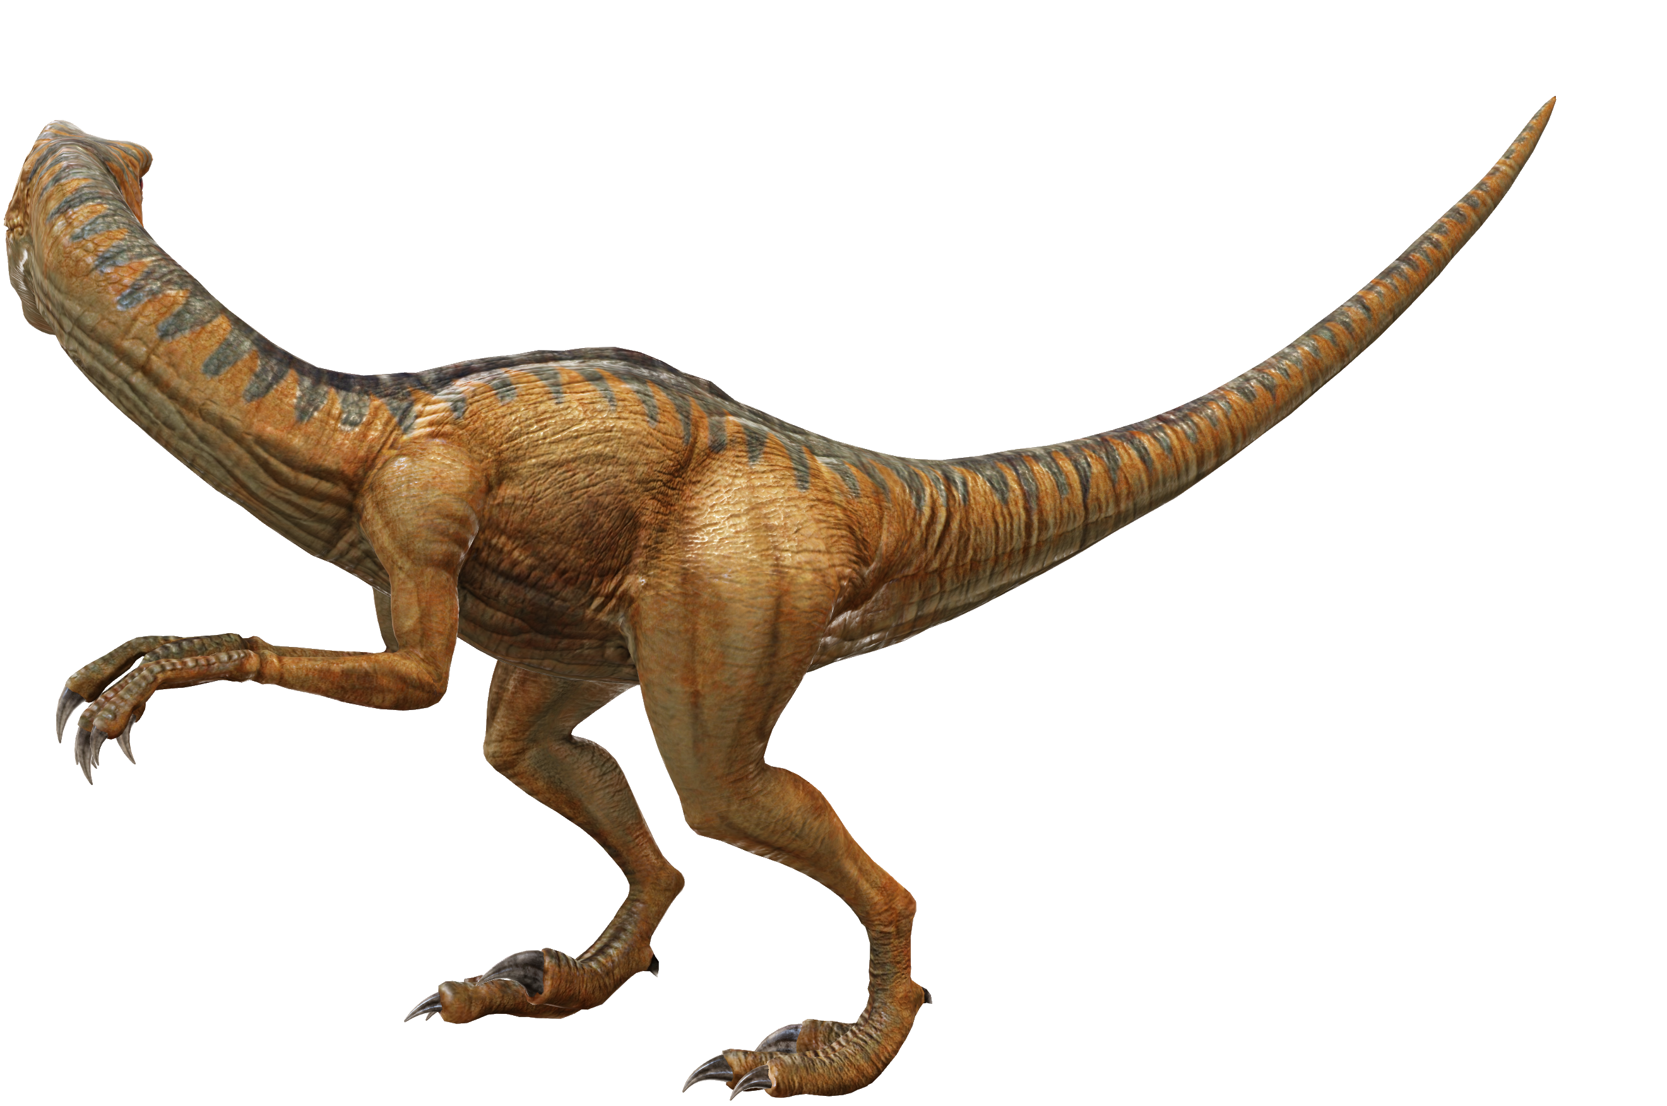
Introduction
Huge networks exist all around us
email communication
social media
e-commerce
Each network holds information regarding the behavior and characteristics of its members.
Extracting this information from known networks, might in turn help in identifying an unknown network.
Centrality values are usually used in analyzing a network

Slide 3
Hypothesis
It is possible to classify networks by applying Unsupervised Learning algorithms on the Centrality values of graphs.
If we prove the null hypothesis, it means networks have no inherent structure that can be discriminated and is mostly traffic/ human behavior driven.
If we can prove our alternative hypothesis, we will be able to prove that there is structure or pattern associated to networks and it is not only behavior/traffic driven. Hence, we can try to classify unknown networks in the future.

Slide 4
Procedure
Literature Review
Collection of usable networks (datasets)
Application of learning algorithms to all datasets
Selection of appropriate Unsupervised learning algorithms
Results Analysis
Selection of appropriate and calculable Centralities
Ablation Study

Slide 5
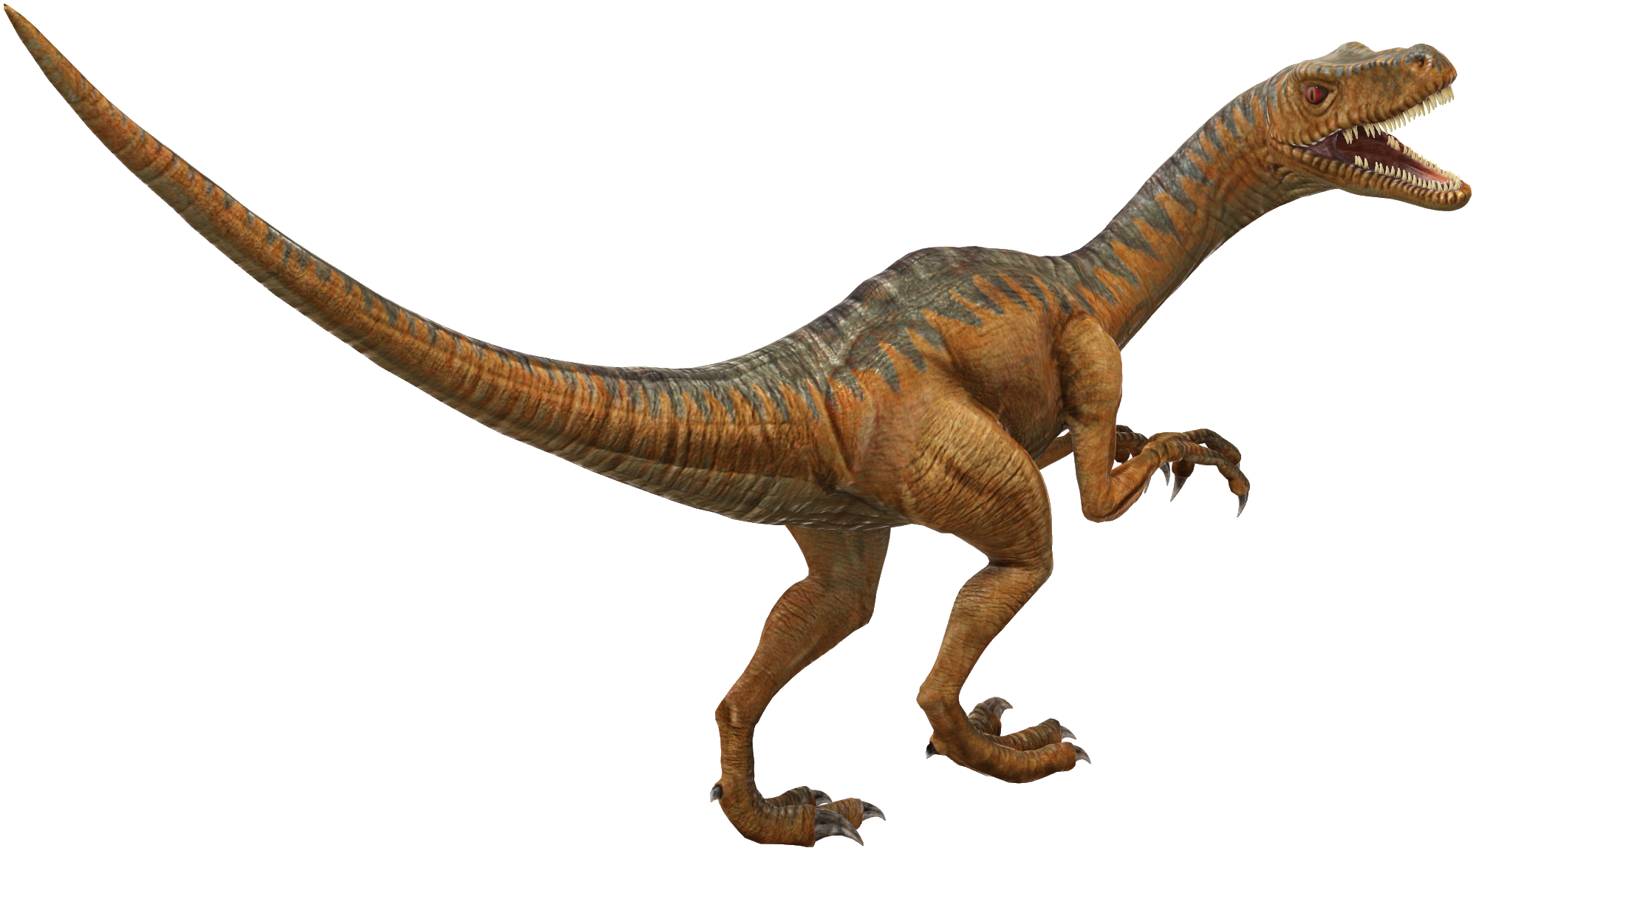
Literature Review
Over the years, network centralities have been used for many different purposes that range from traffic network to brain networks. However, there’s been very little effort to explore network discrimination through centrality measures.
In their work, Wang and Krim[1] showed that discrimination of graph networks are possible through centrality measures. They showed that degree centrality and clustering coefficients were enough to discriminate networks and adding Betweenness Centralities, Eigenvector Centralities or Closeness Centralities degraded the results. However, they only used two small sample datasets for their study.
In his study Dwyer[2] showed that visual analysis to explore and compare the centralities within a given network was possible. In the study the centralities were drawn on a 2D plane that was mapped to 3D plane. Three different methods were employed to this purpose and these were 3D parallel Coordinates-based Comparison, Orbit based comparison and hierarchy based comparison.
Sarrac´en and Rosso [3] used Betweenness centrality to automatically summarize text. In order to do so, they represented the text as an indirected weighted graph where each sentence was represented as a bag of words. They also used similarity/dissimilarity criterion to represent the semantic relation between nodes. Afterwards, a ranking algorithm was used which was based on Betweenness centrality.

Slide 6
Literature Review (cont.)
Wu[4] proposed a novel graph clustering algorithm which used Betweenness centrality recursively to create groups of clusters called LEADER which guided the algorithm to cluster the whole network.
Huang et el.[5] proposed a visual analytics method to explore urban traffic mobility patterns. They used Pagerank and Betweenness centralities to calculate the more central/ important streets. Pagerank detected hub streets and Betweenness detected street/region that acted as back-bone in urban networks.
Crucitti[6] used Closeness, Betweenness, Straightness and information centralities to capture street patterns of different cities of the world. They proposed that a hierarchichal clustering based on distribution of centrality measures are capable of distinguishing different cities to some extent.
Zhang[7] used degree, betweennesss and closeness centrality to calculate different road patterns. The aim of their study was to discriminate different road patterns using centralities. The centralities were calculated using a topological network representation of the road networks.

Slide 7
Selected Datasets
Social Networks:
Ego-Facebook
Gemsec-Facebook
Ego-Twitter
Musae-Twitch
Feather-Lastfm
Ground truth networks:
Com-DBLP
Communication networks:
Email-EuAll
Email-enron
Citation networks:
Cit-HepPH
Cit-HepTH
Collaboration networks:
Ca-AstroPH
Ca-HepPH
Product co-purchase networks:
Amazon0302
Amazon0601
Internet P2P networks:
P2P-Gnutella04
P2P-Gnutella30
P2P-Gnutella31
Signed Networks:
Soc-sign-Slashdot090221

Slide 8
Selected Centralities
Degree centrality
Betweenness centrality
Eigenvector centrality
Closeness centrality
Page Rank centrality
Authority centrality
Hub centrality
DMNC - Density of Maximum Neighborhood Component centrality
Lobby Index centrality
Leverage centrality
Eccentricity centrality
Information centrality
Local Bridging centrality

Slide 9
Ablation Study
Model 1- All centralities – 13 variables
Model 2 - without degree – 12 variables
To see how degree, which signifies the connectivity of the nodes, affect the model
Model 3 – Without community centralities and information centrality– 7 variables
To see how well the model performs when only centralities that are calculated globally (WITHOUT taking neighborhood/ community into account) are used
Model 4 – Without node centralities – 6 variables
To see how the model performs when global centralities are taken out of the equation and centralities that depend on neighborhood/ community are used
Model 5 - without eigenvector, pagerank, hubscore, authority – uses ranking – 9 variables
To see how the impact of “importance” amongst nodes differs from the impact of “distance” between nodes
Model 6 - without betweenness, eccentricity, closeness, information – uses distance – 9 variables
To see how the impact of “distance” between nodes differs from the impact of “importance” amongst nodes
Model 7- without leverage, lobby, dmnc, local bridging, information centrality, eigenvector, closeness – 6 variables – mix and match
To see how more global information received about “centrality” of nodes with some community information impacts the model
Model 8- without degree, hubscore, authority, betweenness, information, Eccentricity, leverage– 6 variables – mix and match
To see how equal proportions of community and node importance information affects the model
Model 9- without Closeness, eigenvector, authority, hubscore, Betweenness, Leverage, Information Centrality,
To see how more information about community and some information about node importance affects the model

Slide 10
Algorithms
Data Analysis:
Boxplot
Correlation matrix
Unsupervised Learning/Clustering / Non-linear dimension reduction:
Principle Component Analysis (PCA)
t-SNE
k-means clustering
Density-based spatial clustering of applications with noise (DBSCAN)
Umap
Sammons map

Slide 11
RESULTS
(on the P2P-Gnutella04 dataset)

Slide 12
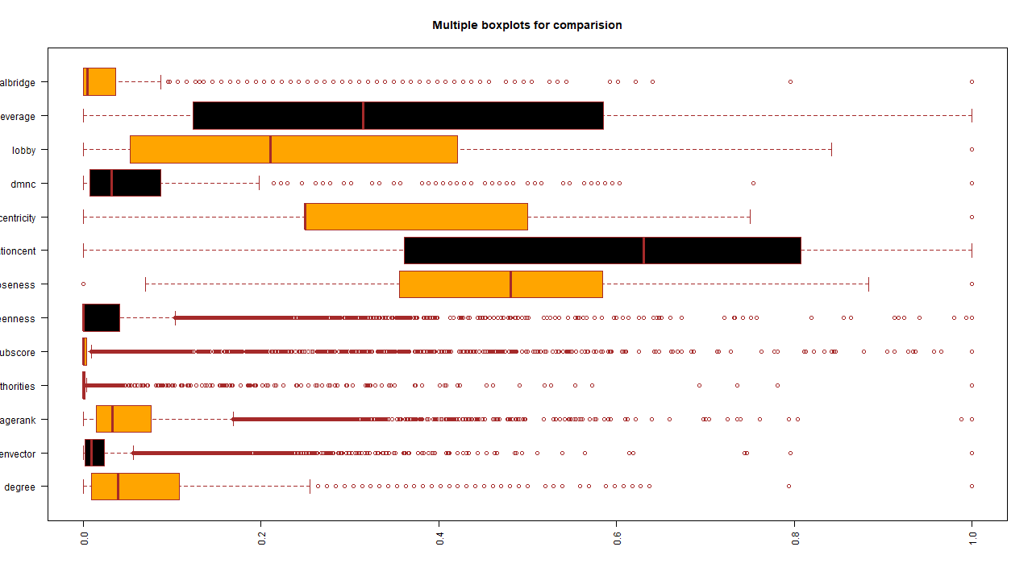
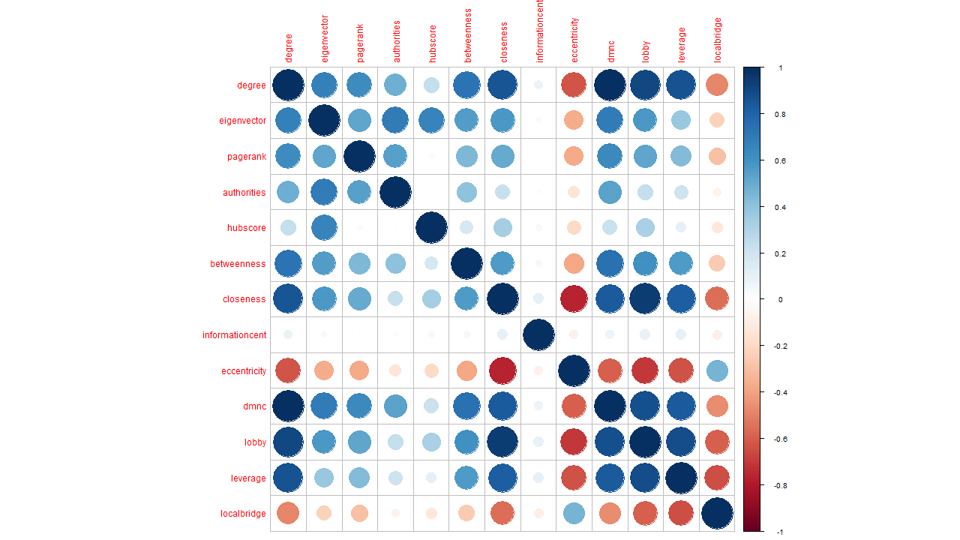
DATA
ANALYSIS
Boxplot
Correlation plot

Slide 13
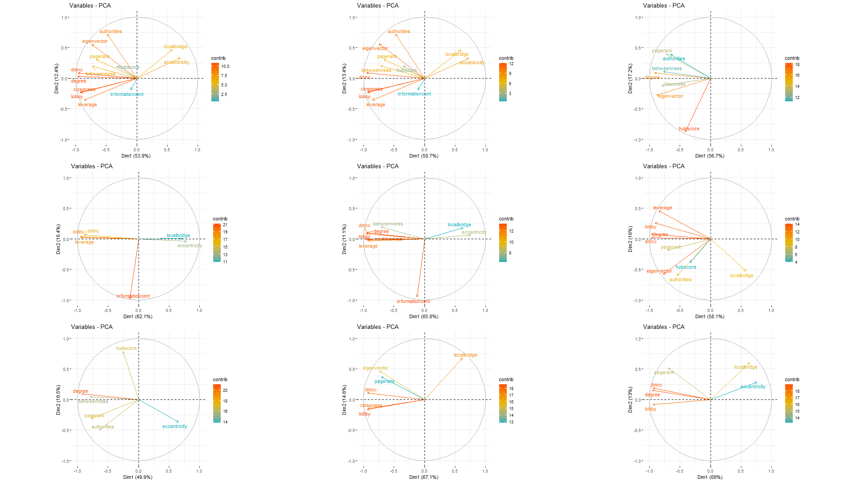
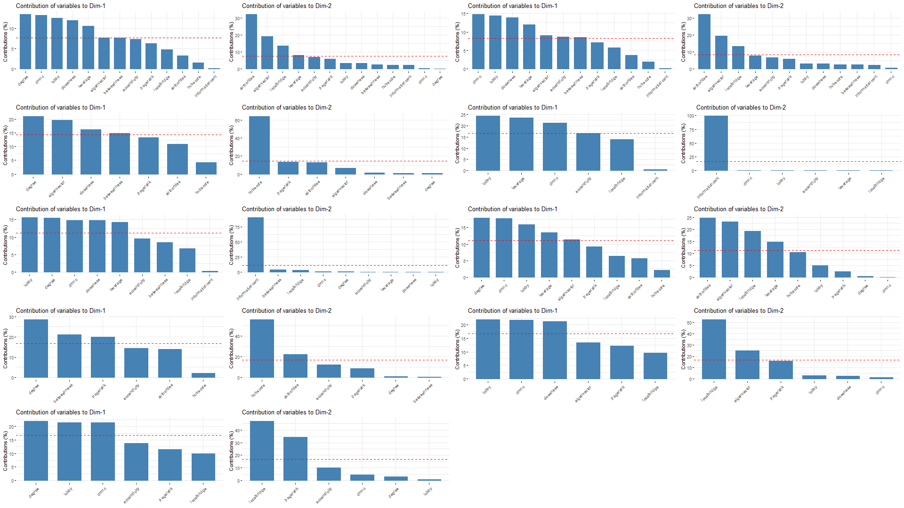
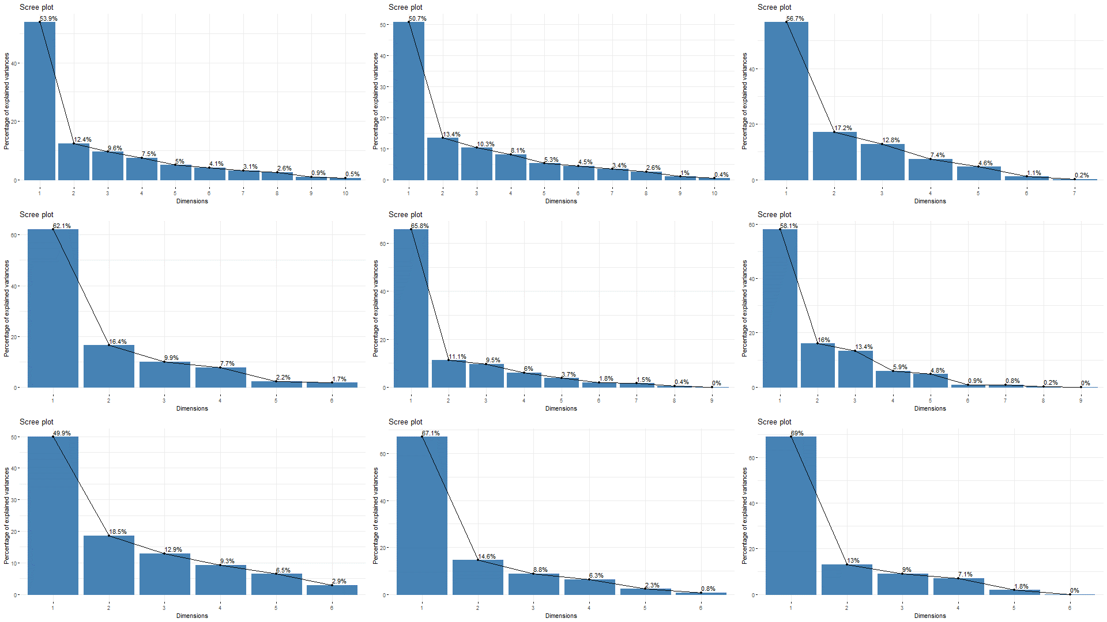
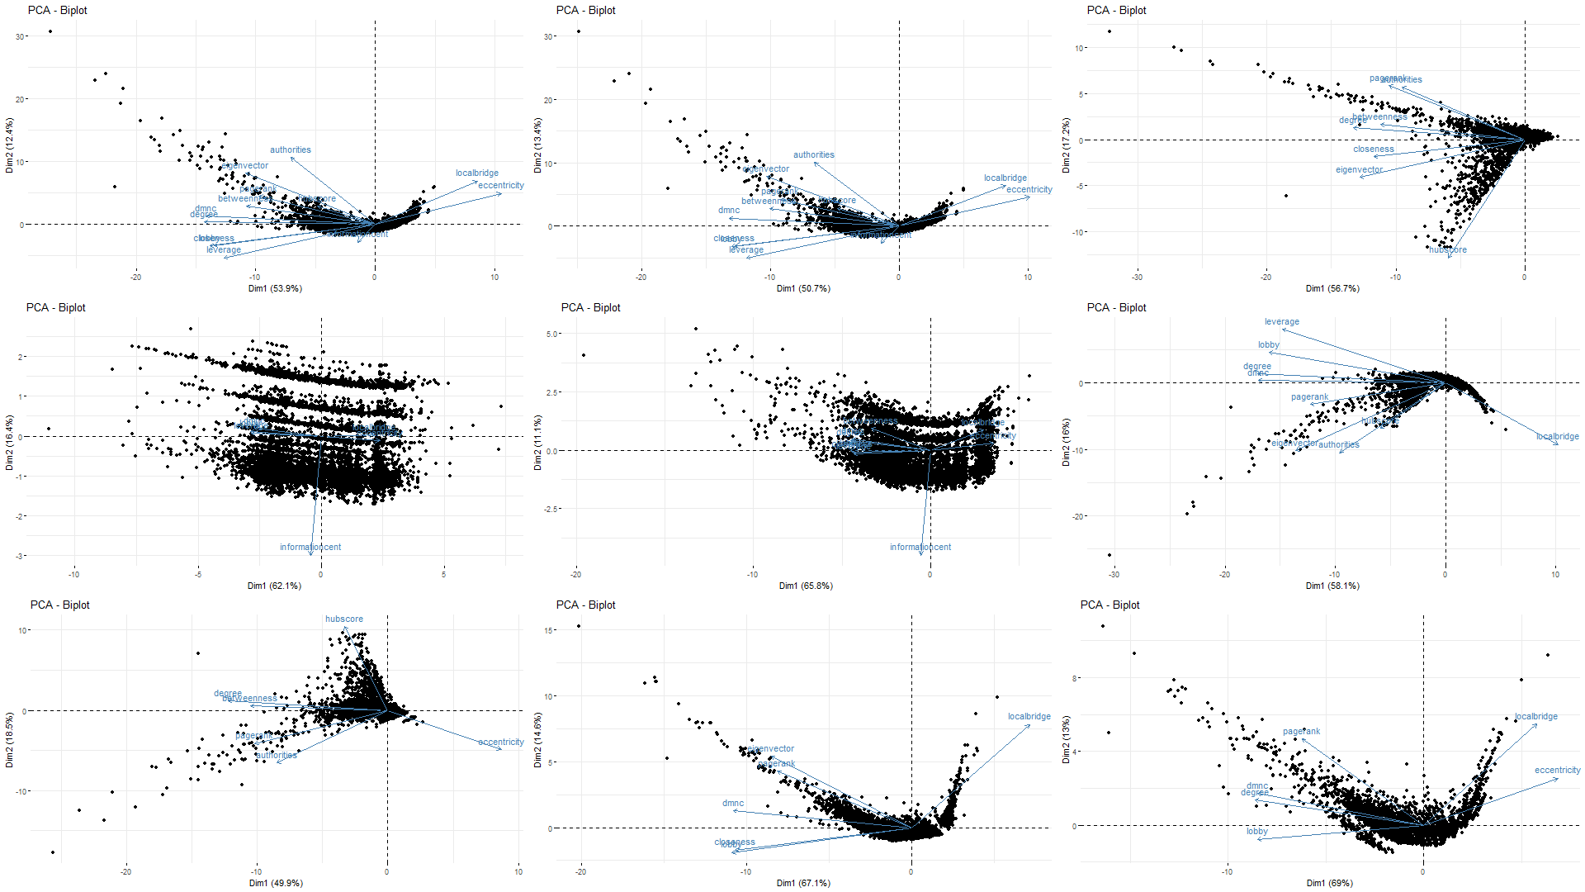
PCA
PLOTS
Cos2 Contribution
Dimension Contribution
Scree plot
Biplot

Slide 14
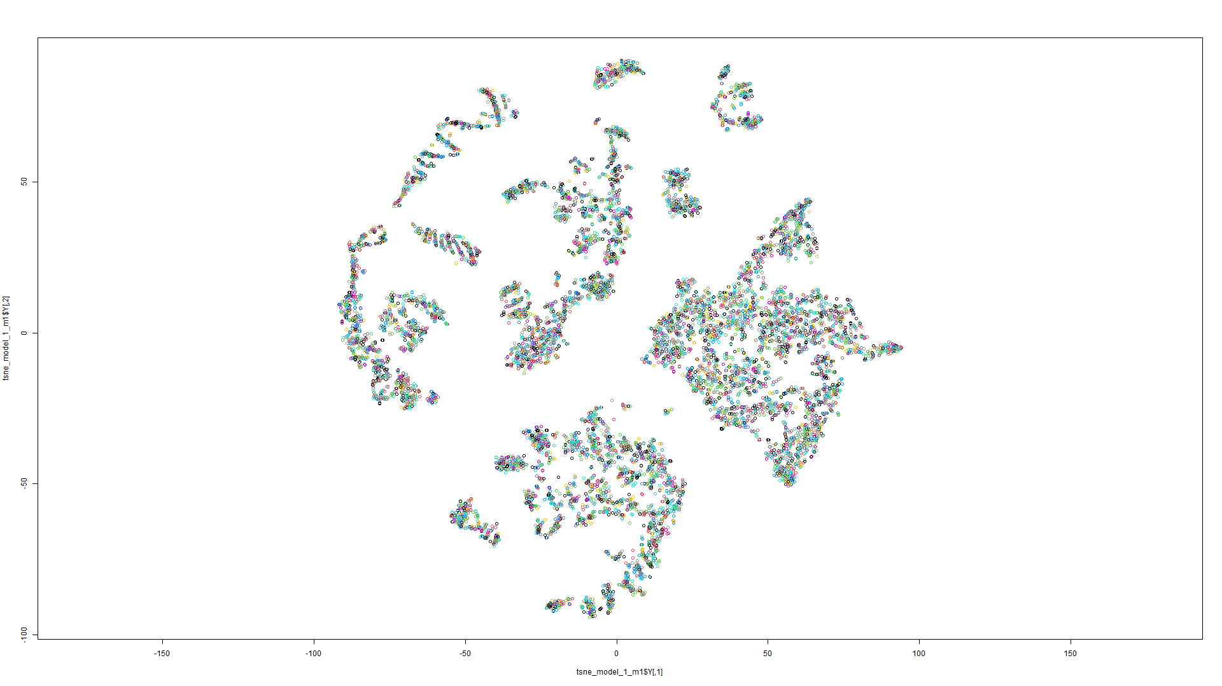
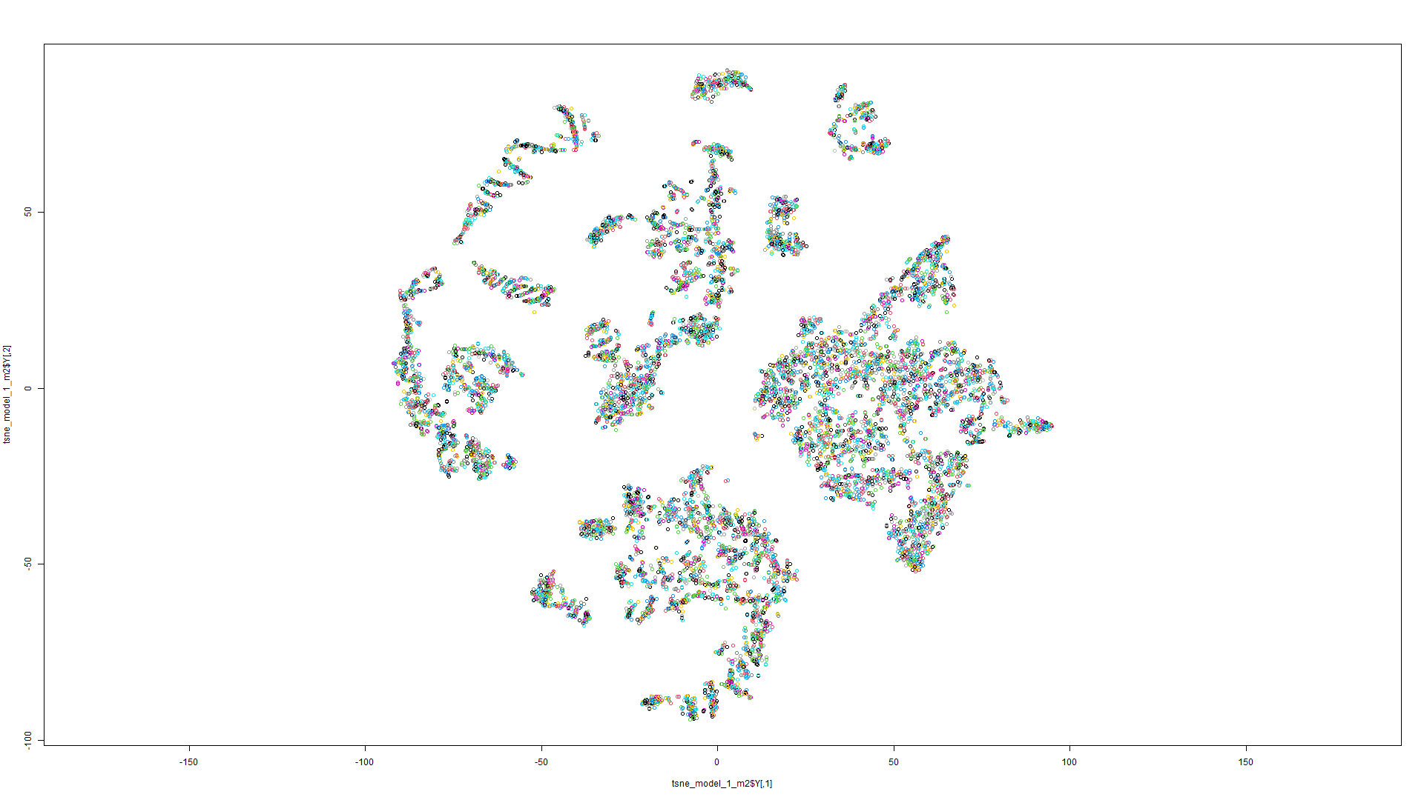
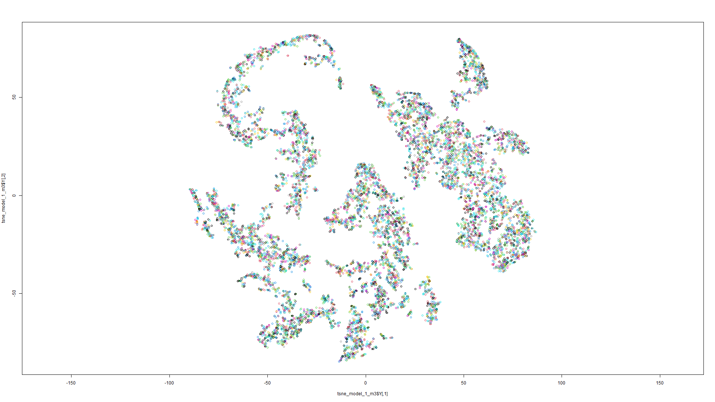
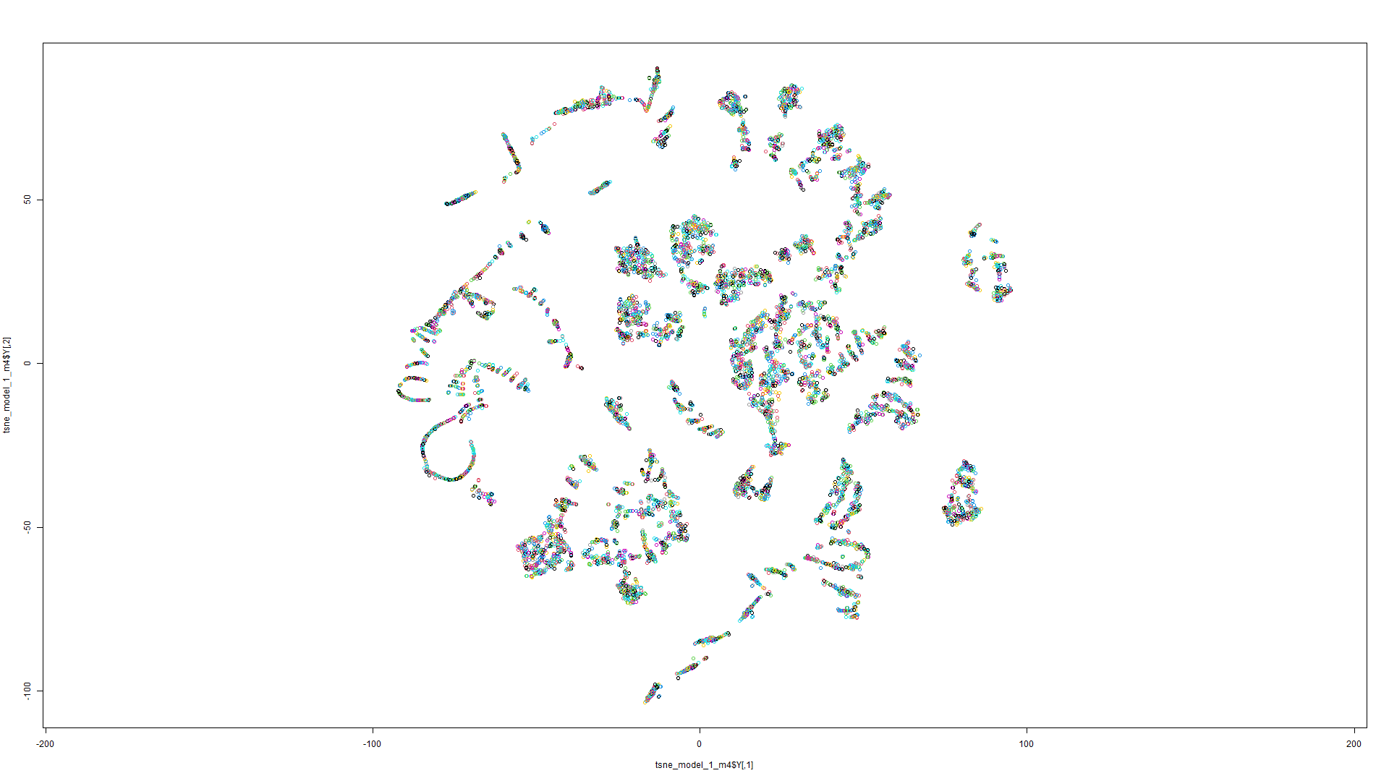
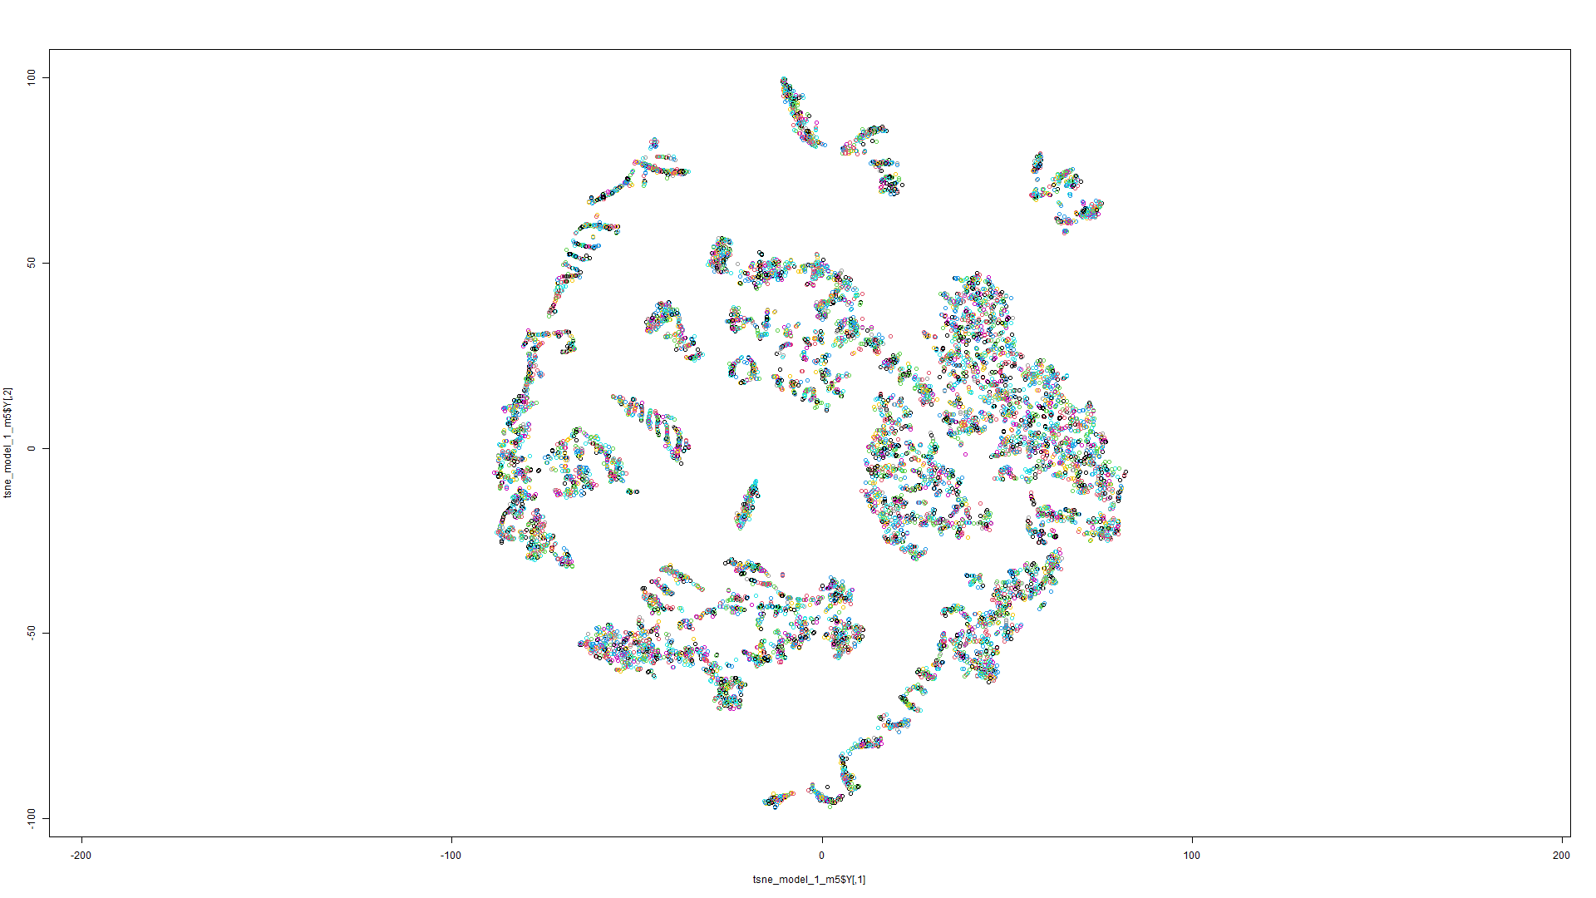
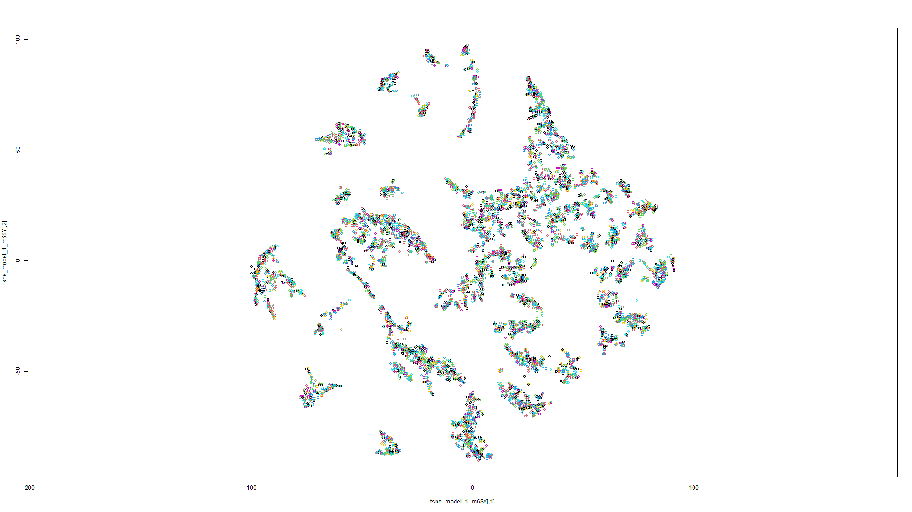
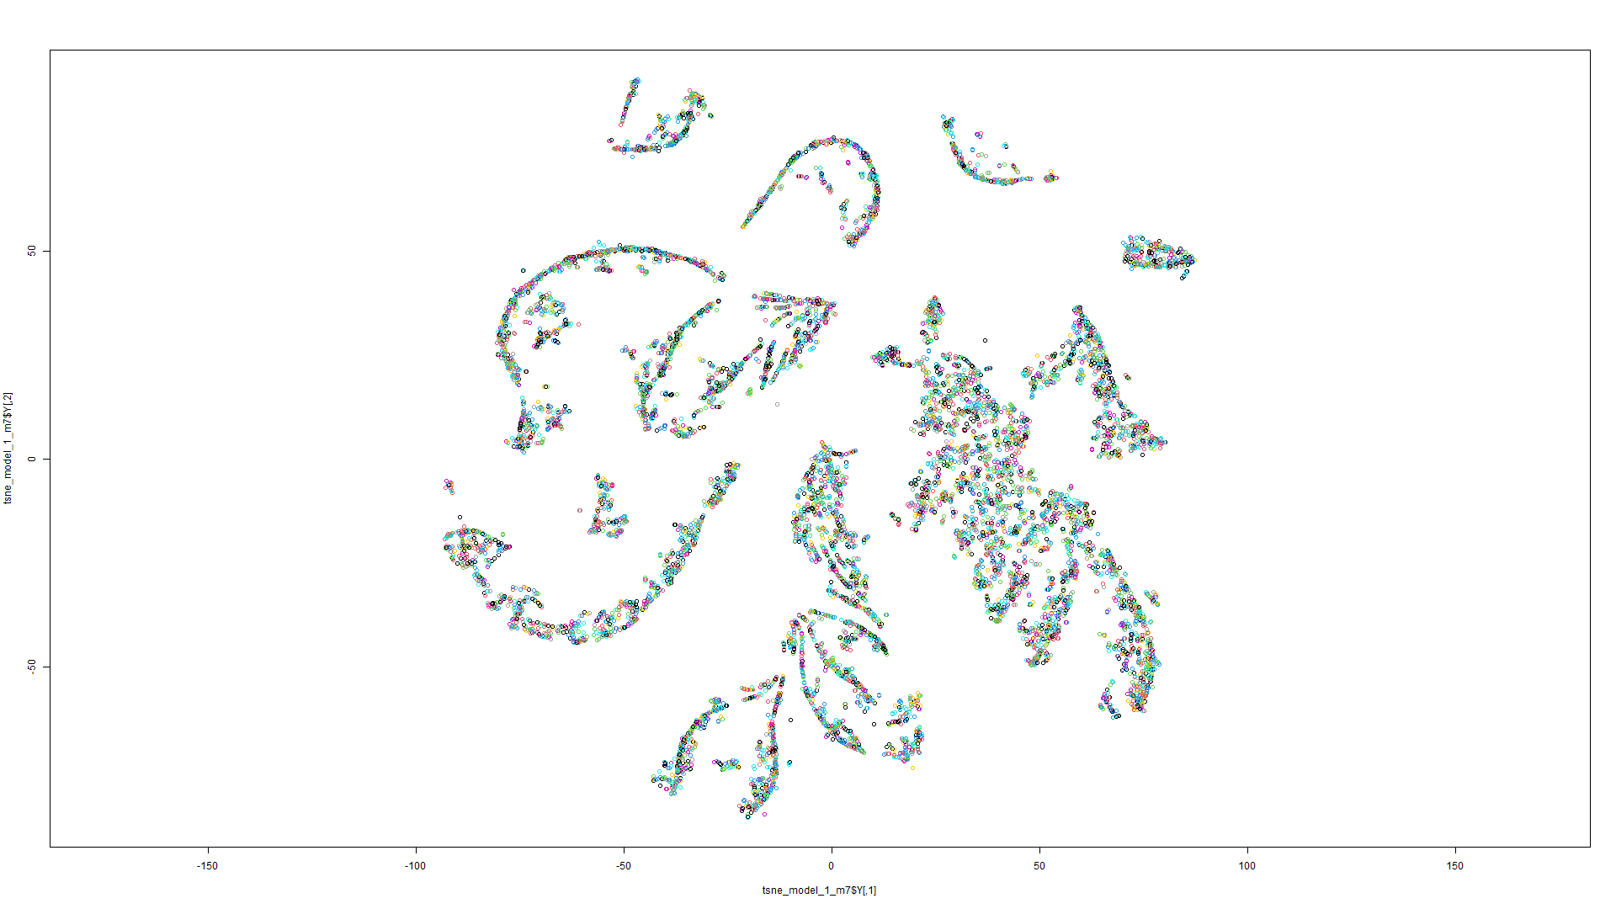
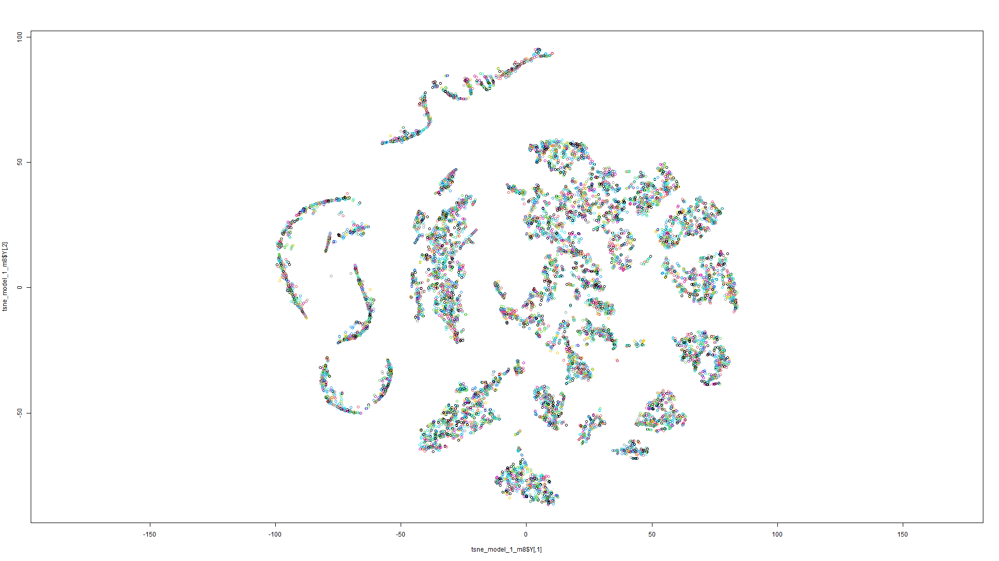
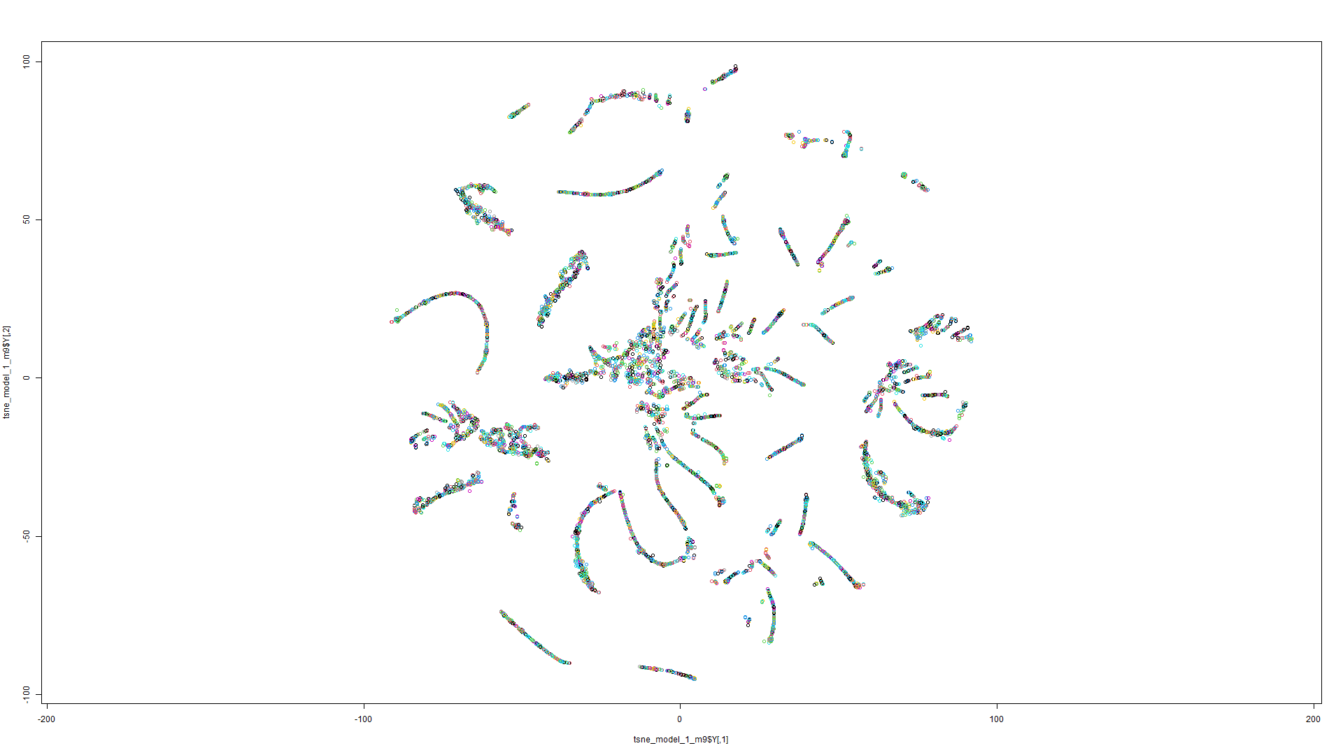
t-
S
N
E
P
L
O
T
S
(1st
M
O
D
E
L)
Model 1
Model 2
Model 3
Model 4
Model 5
Model 6
Model 7
Model 8
Model 9

Slide 15
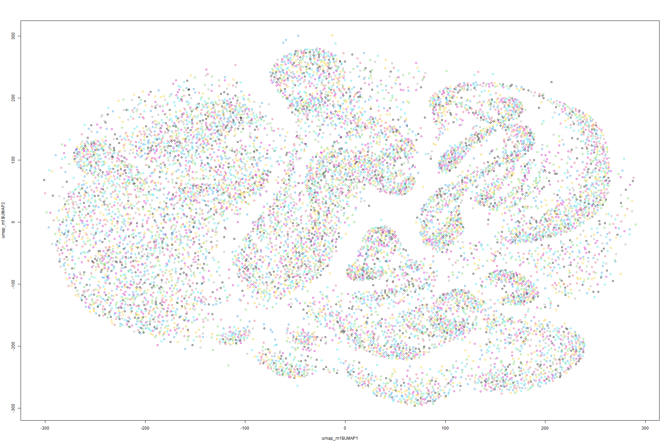
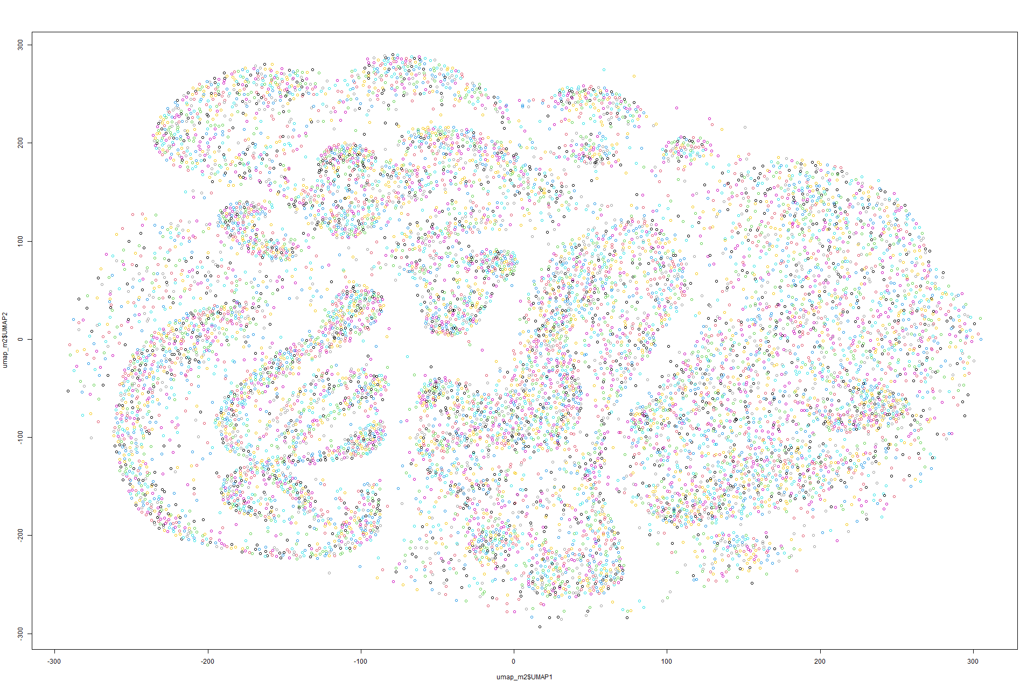
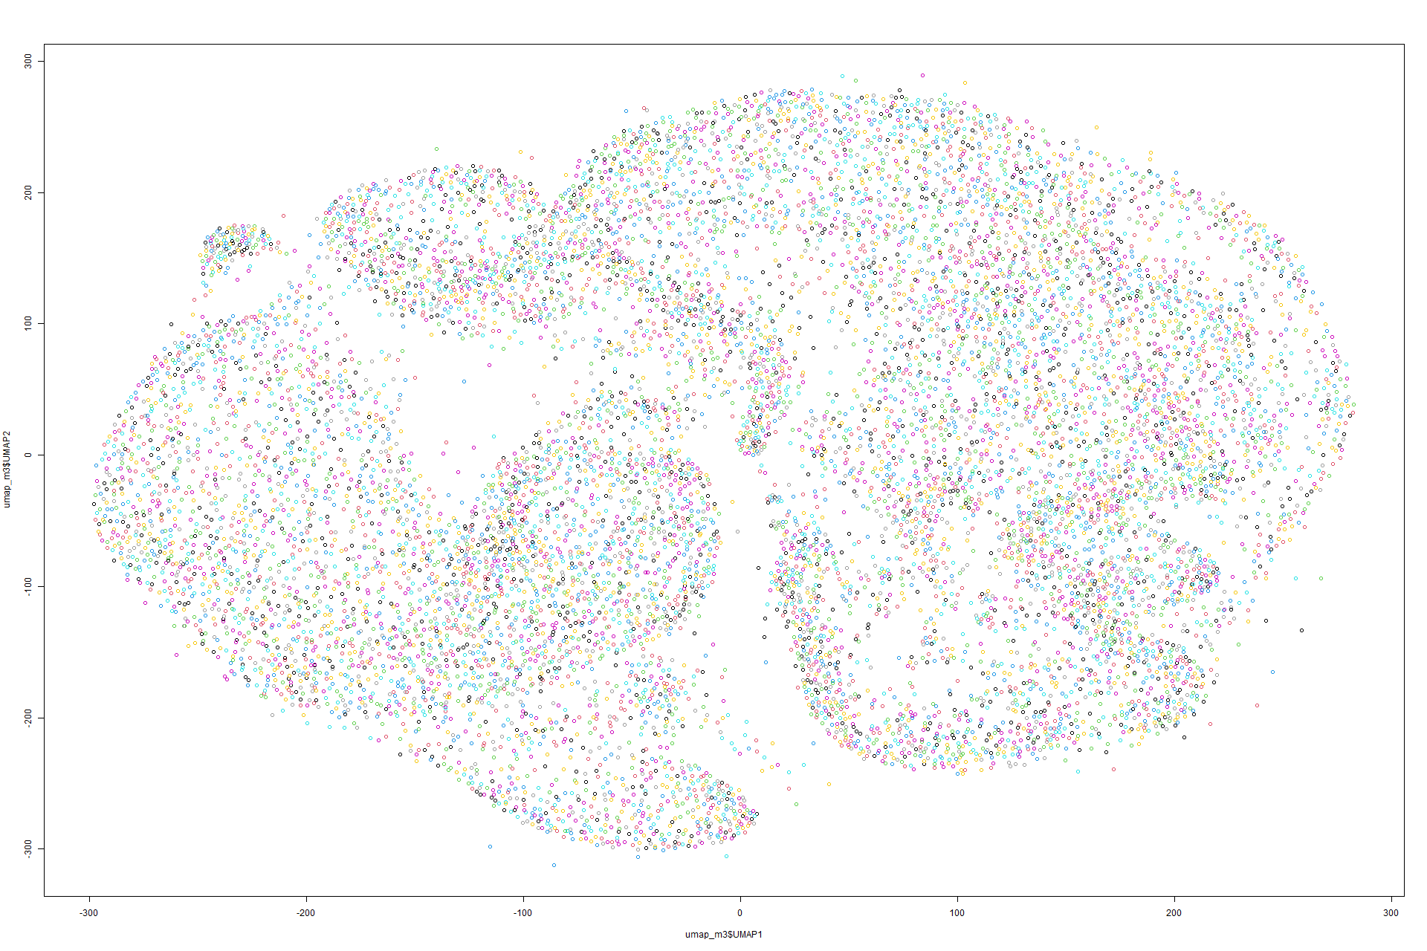
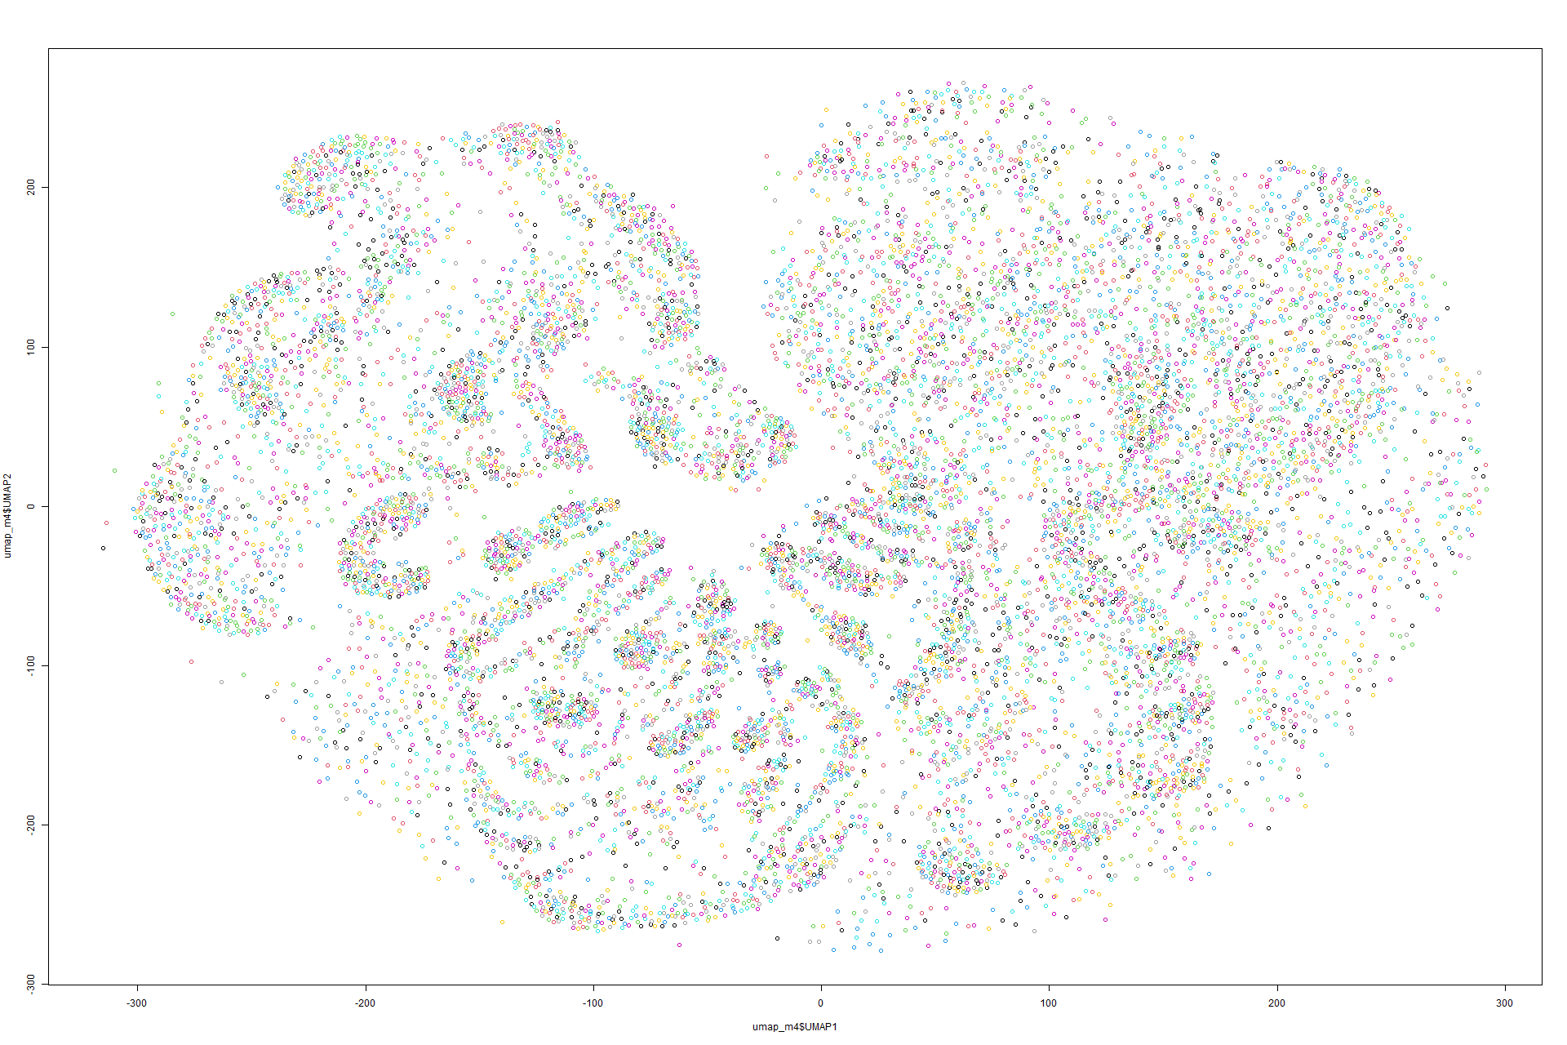
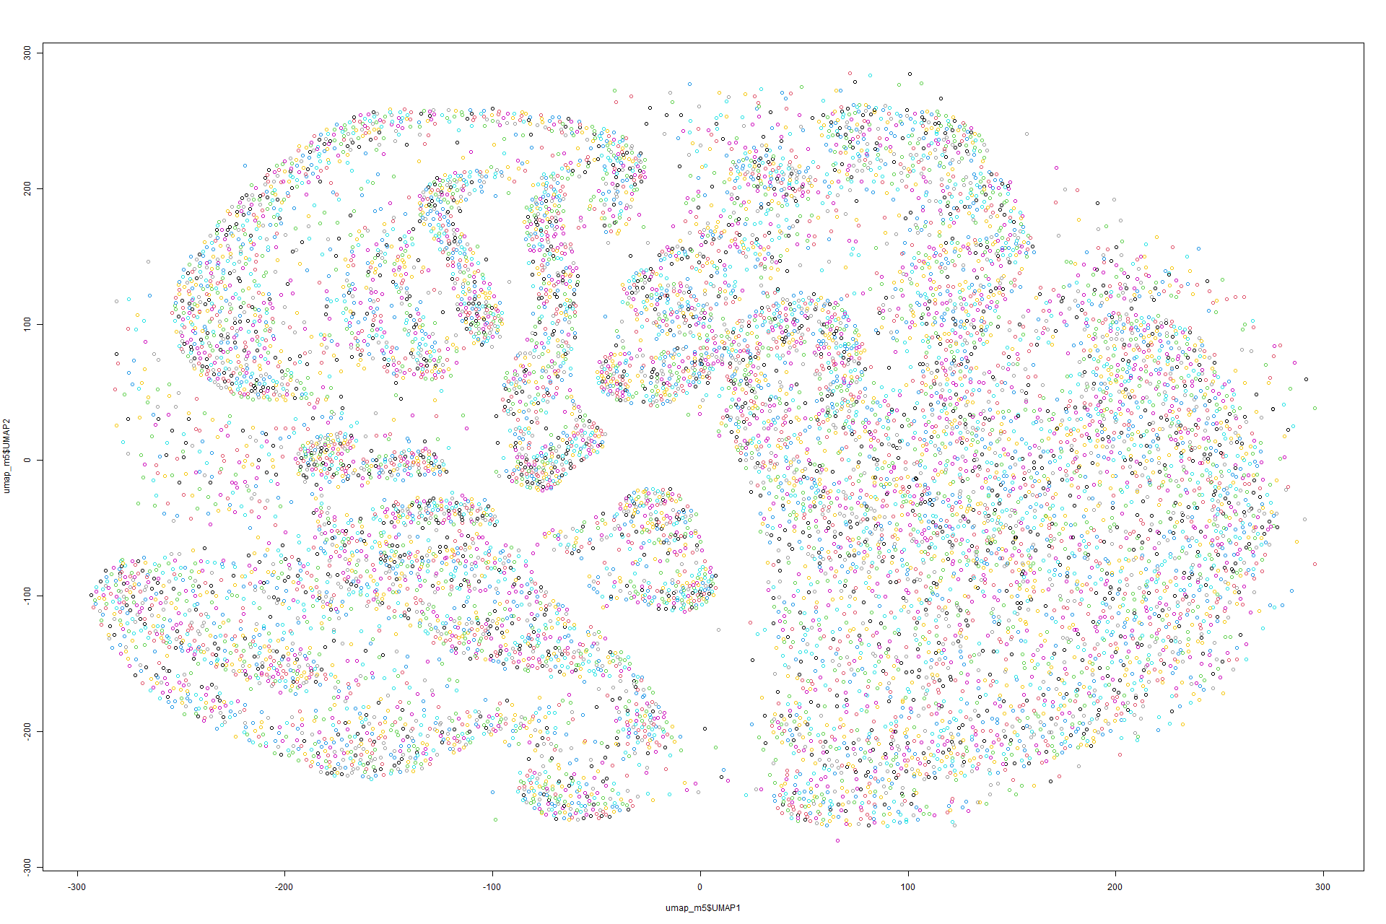
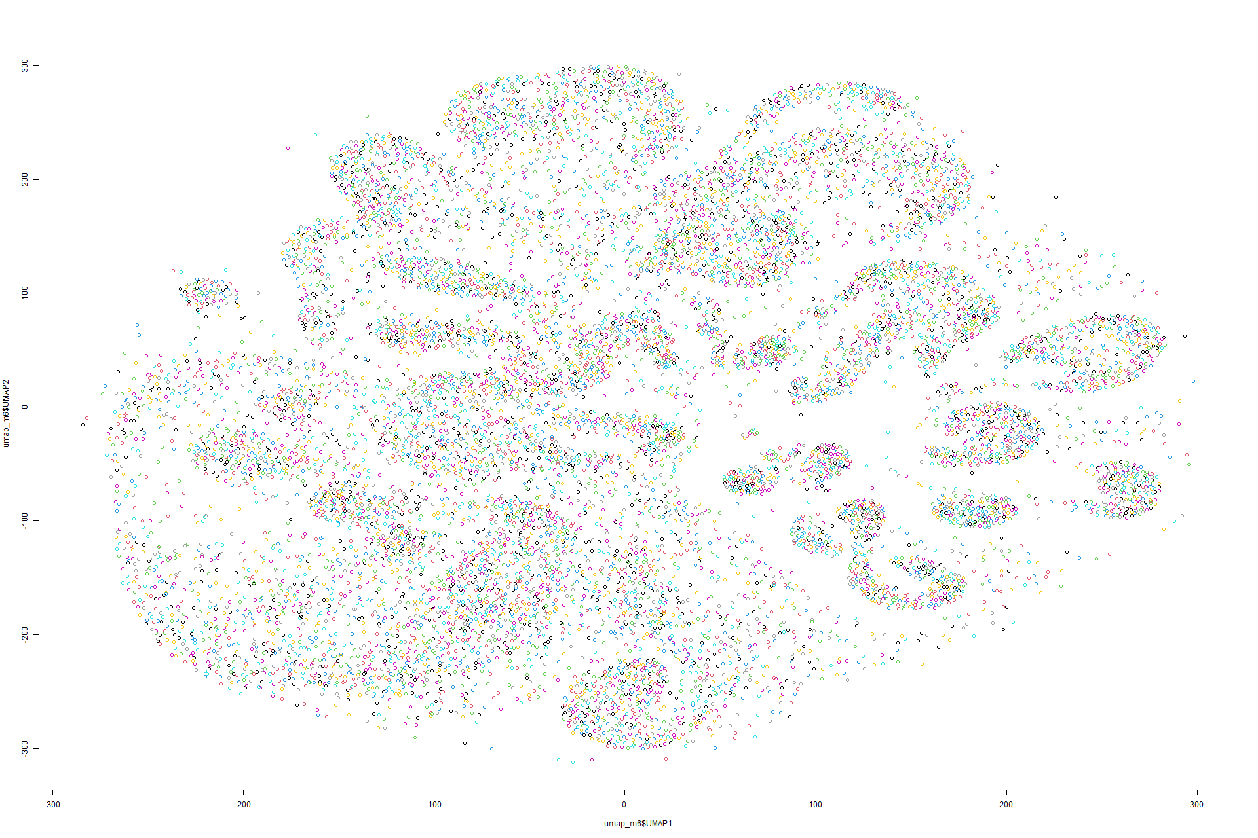
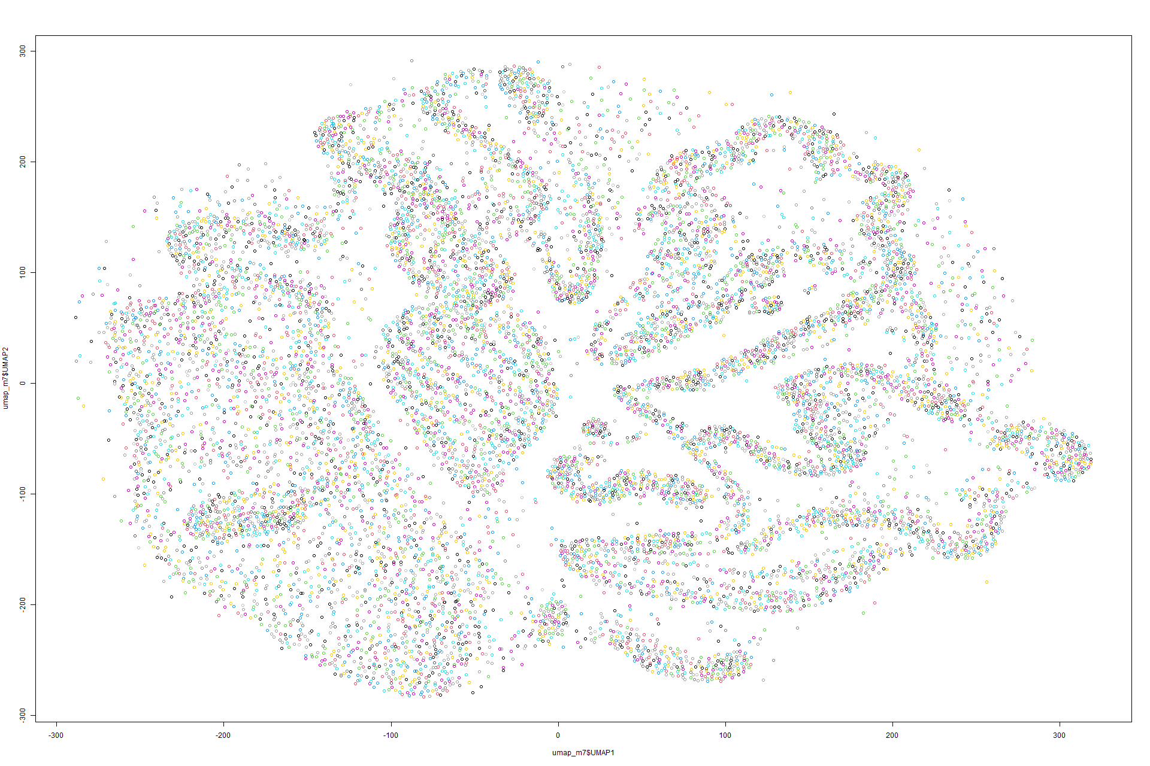
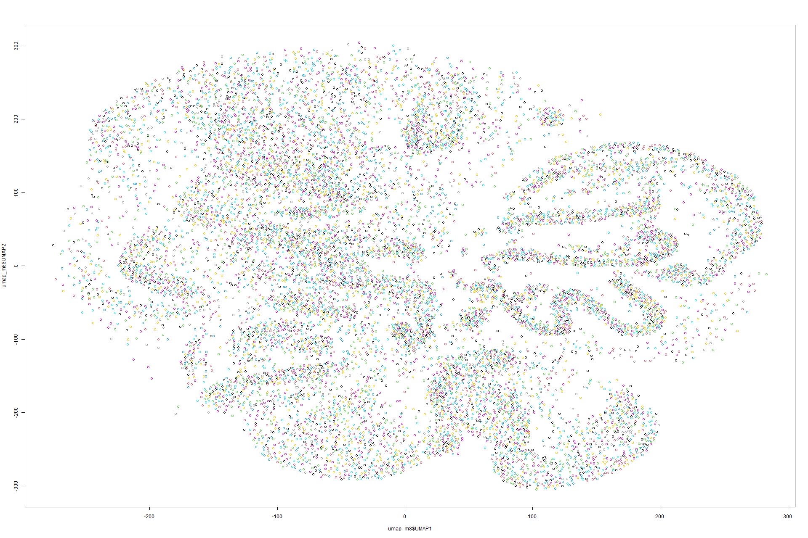
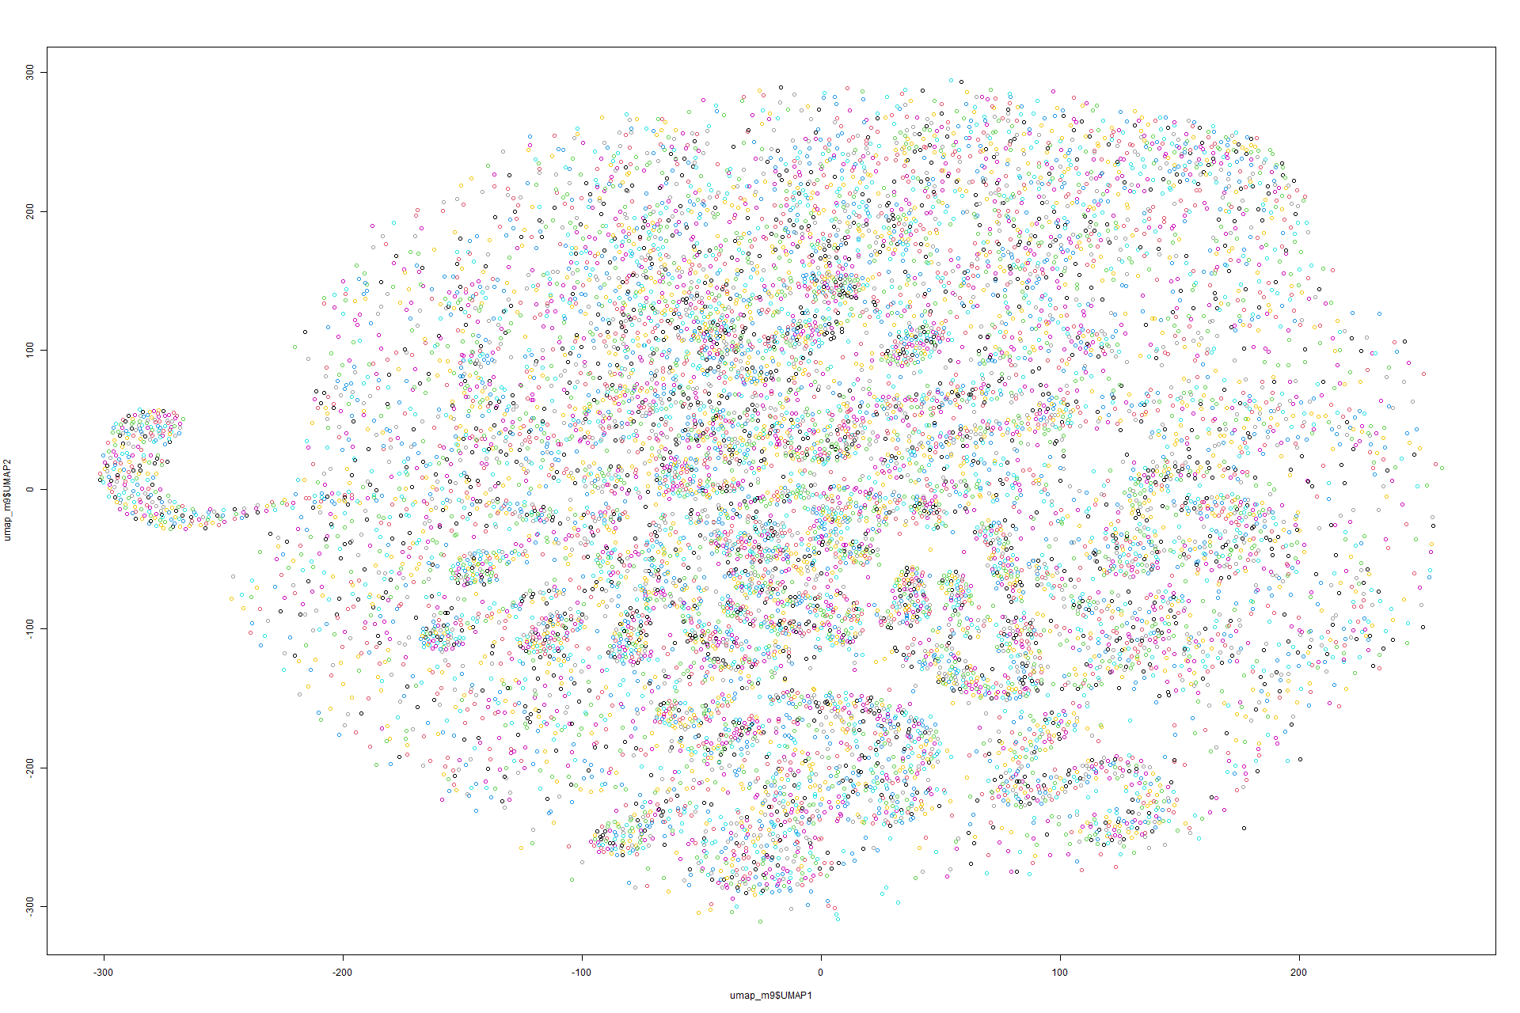
UMAP
PLOTS
Model 1
Model 2
Model 3
Model 4
Model 5
Model 6
Model 7
Model 8
Model 9

Slide 16
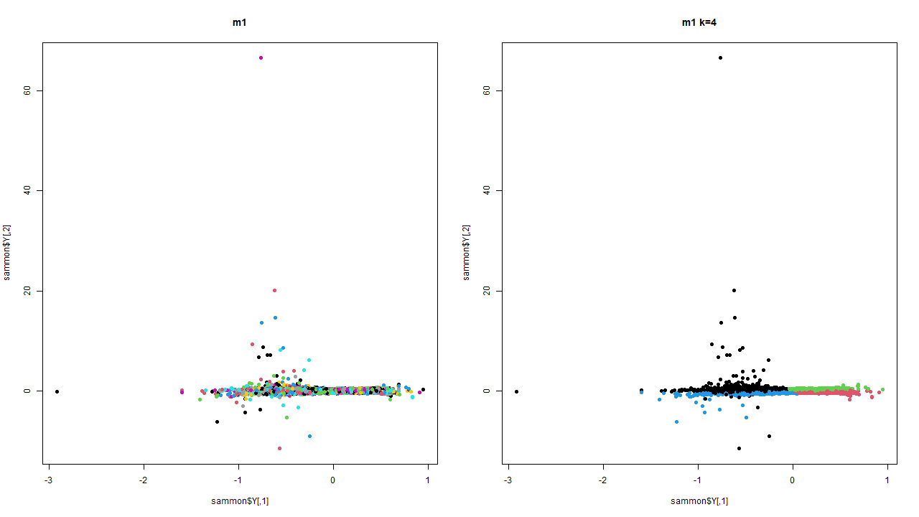
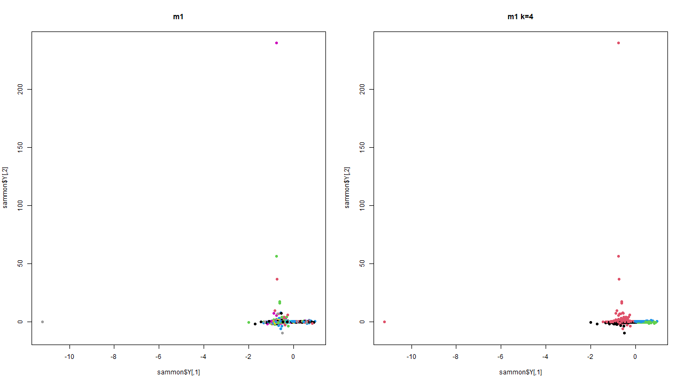
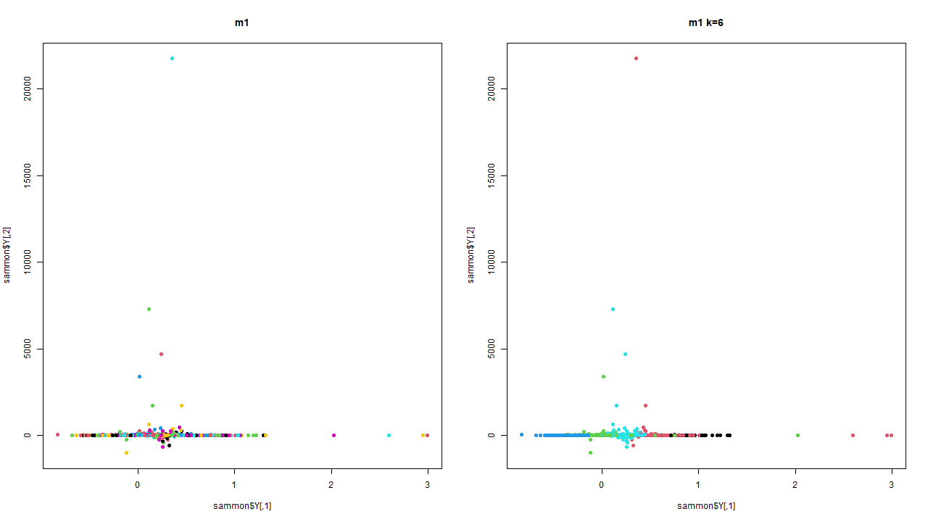
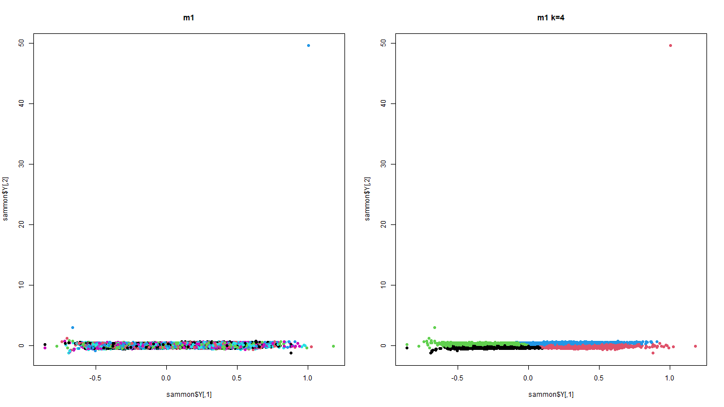
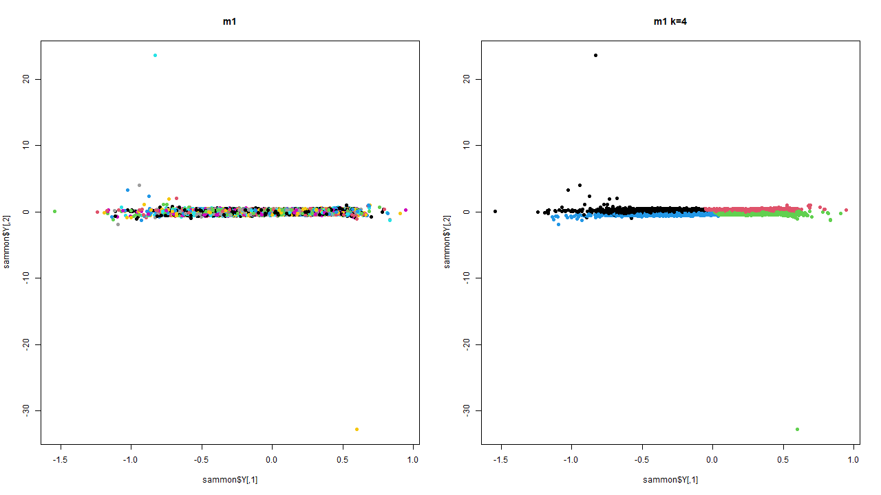
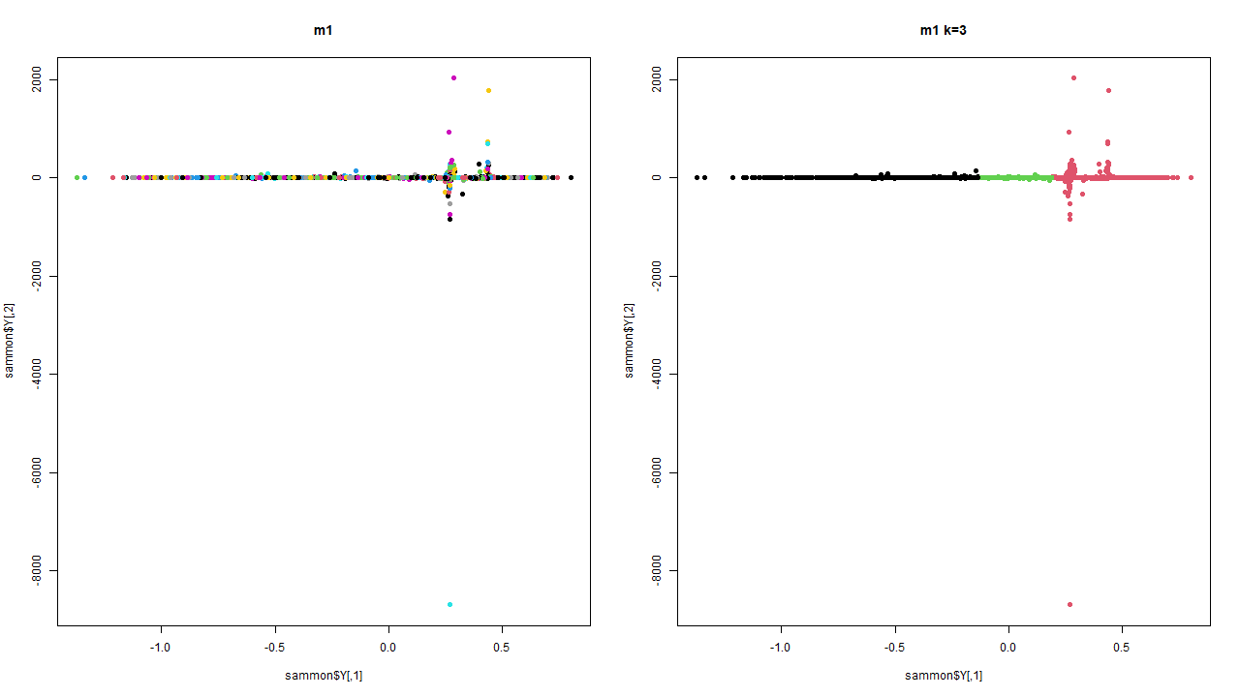
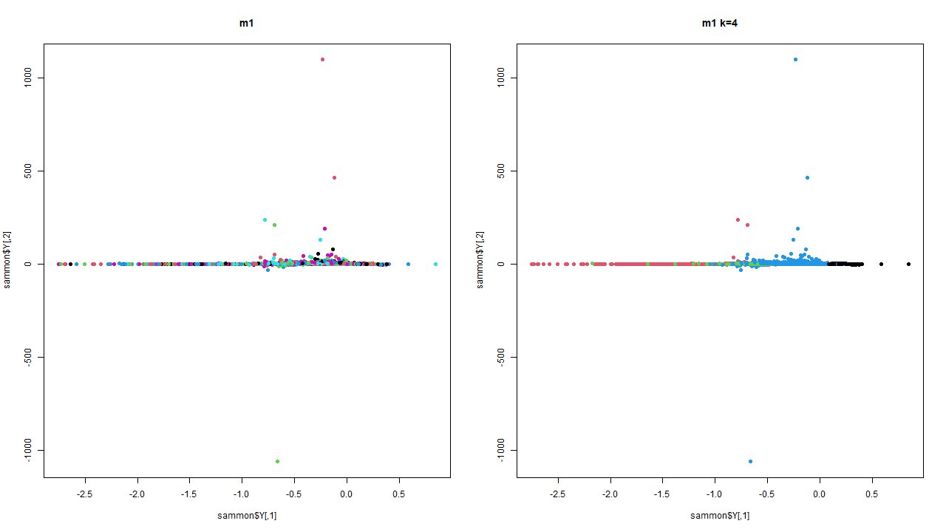
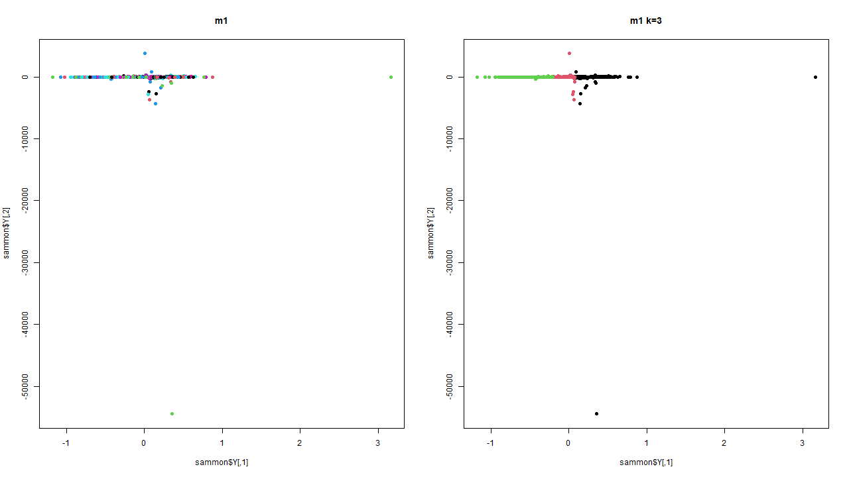
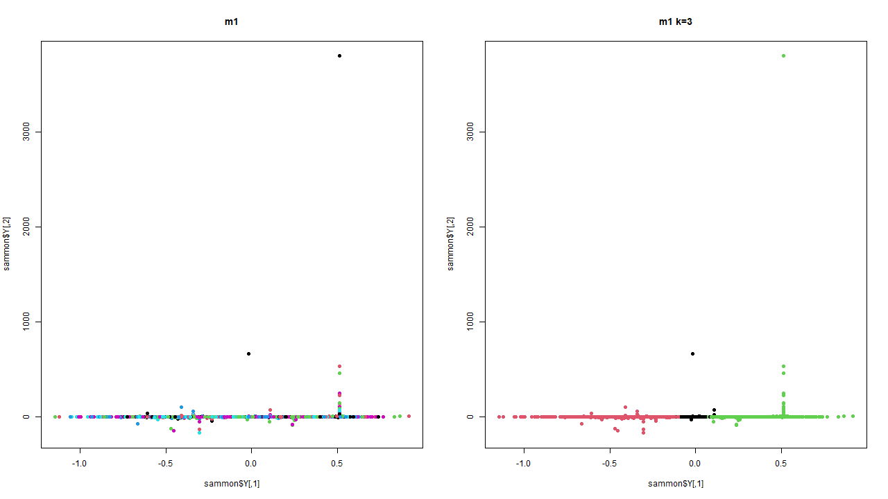
SAMMON
MAP
PLOTS
Model 1
Model 2
Model 3
Model 4
Model 5
Model 6
Model 7
Model 8
Model 9

Slide 17
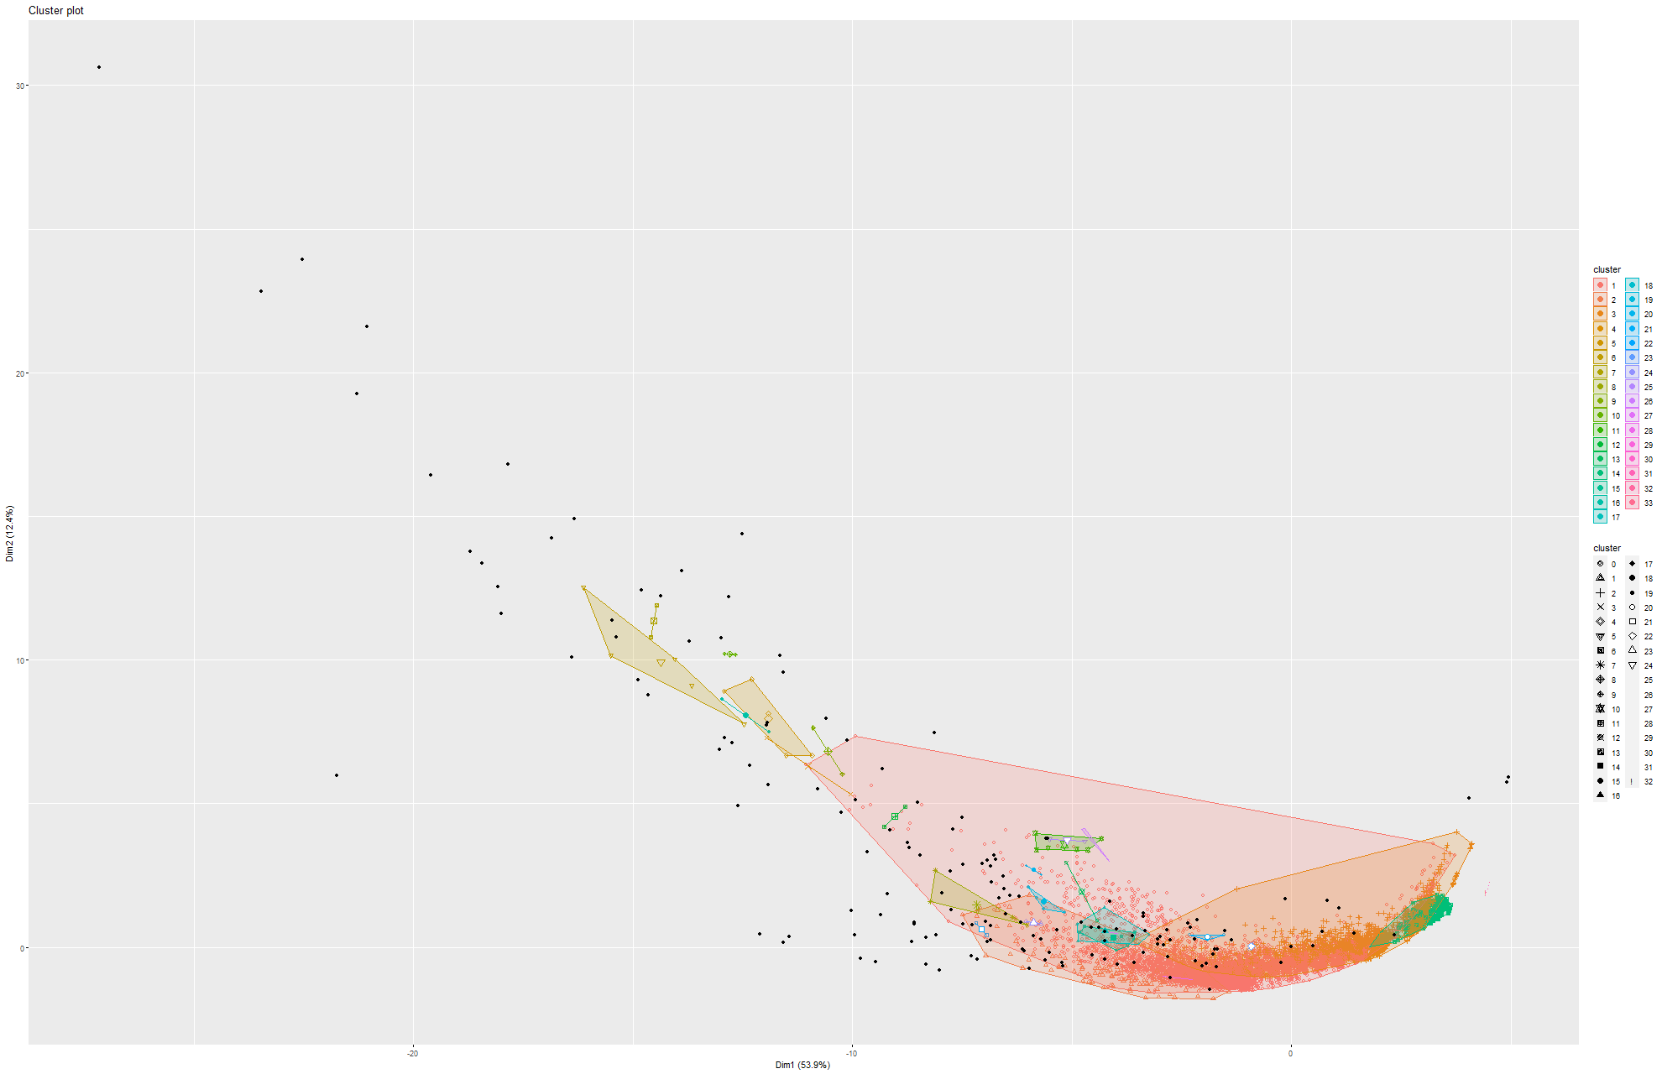
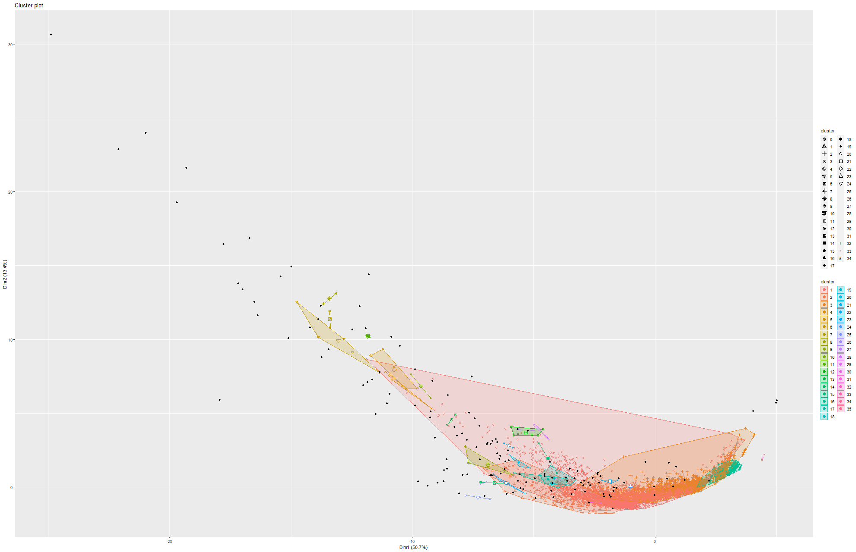
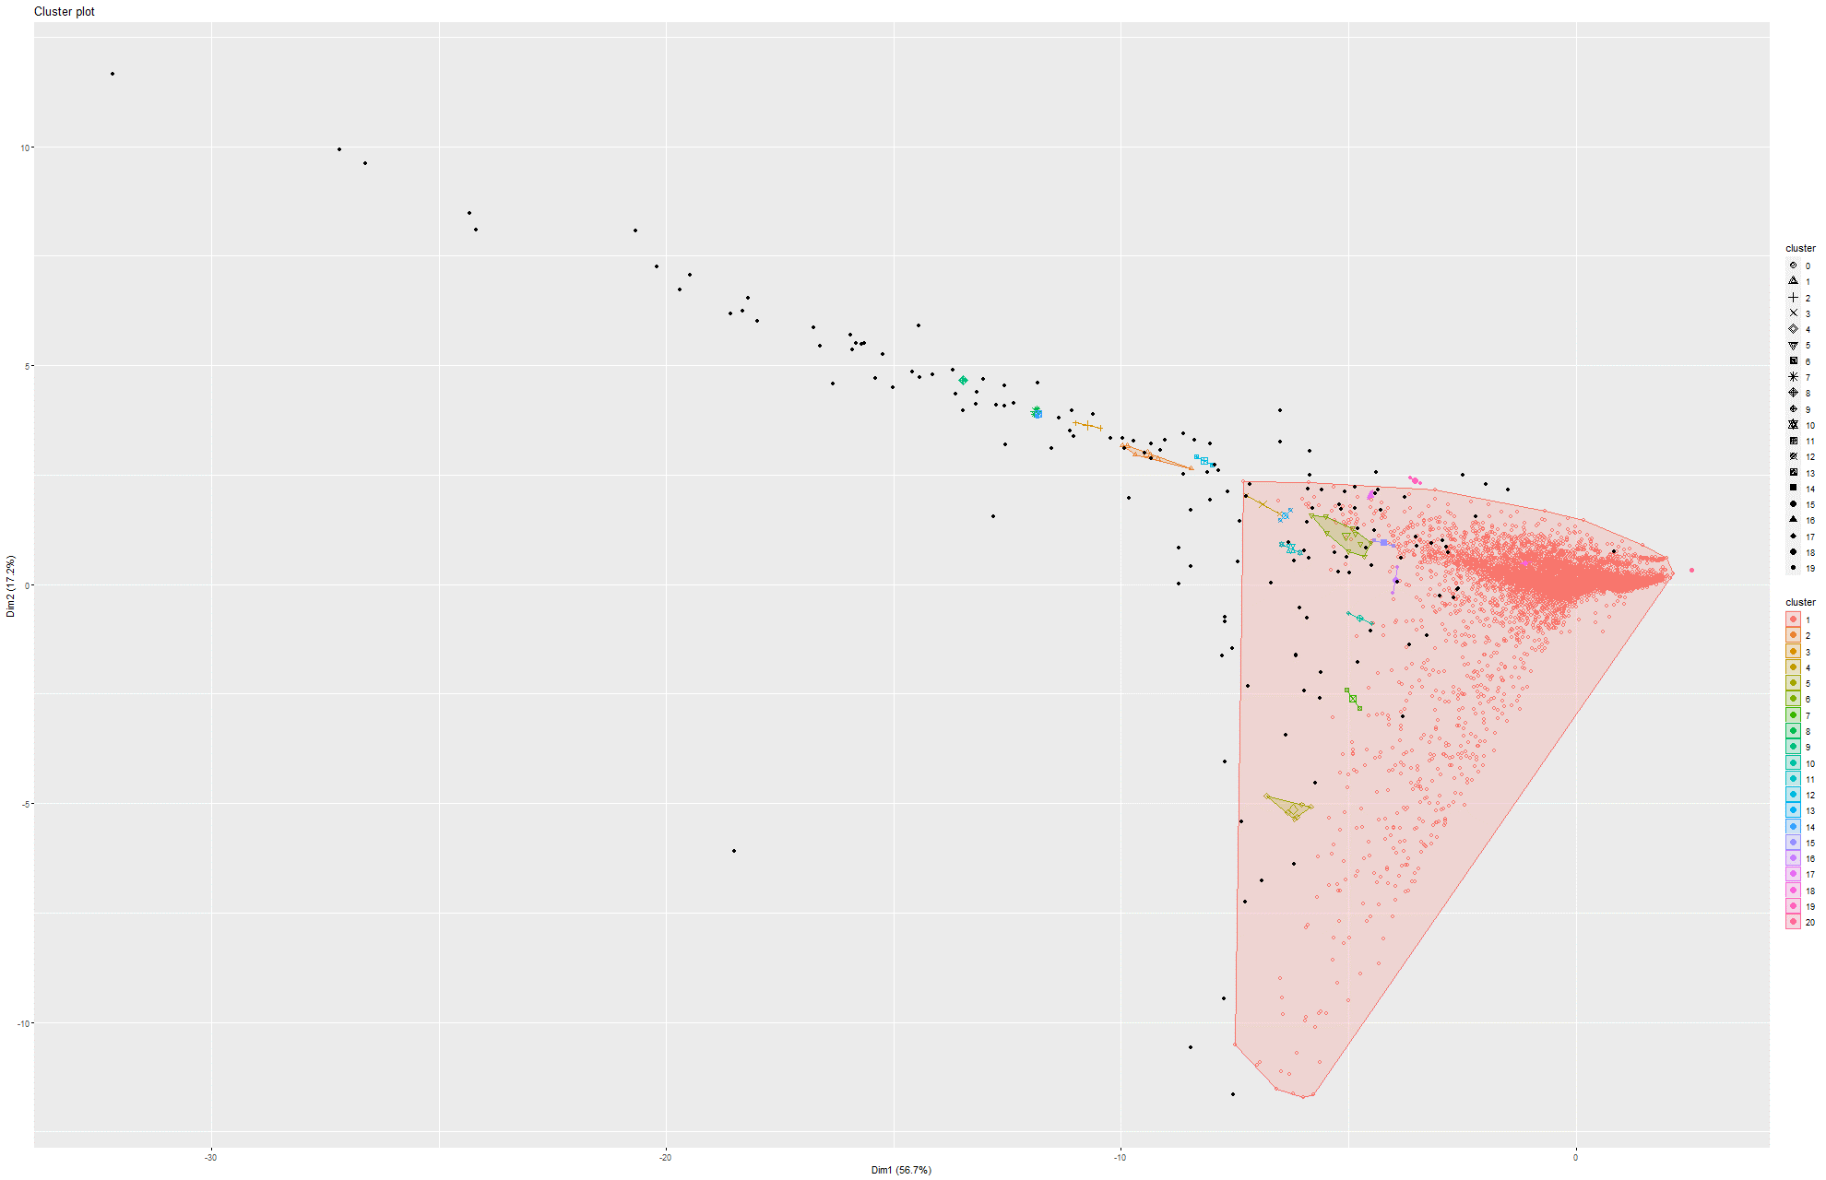
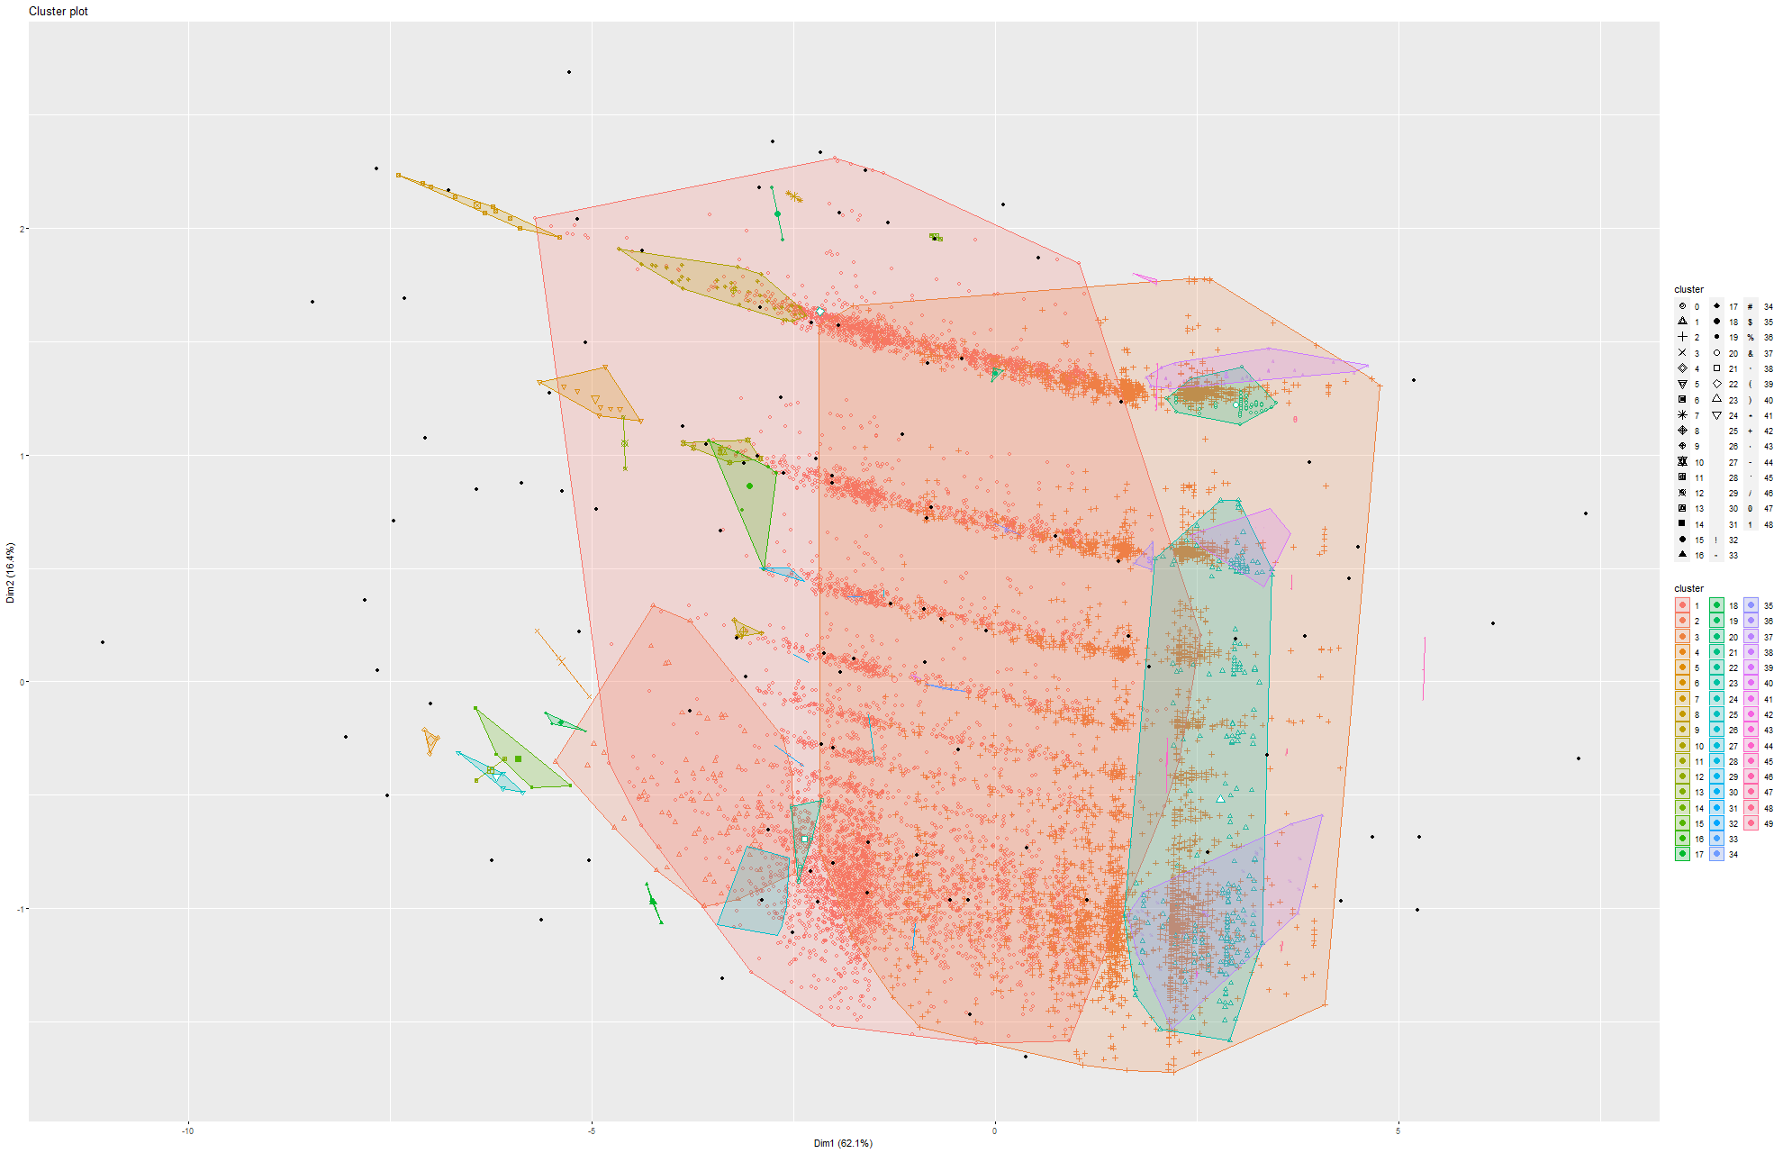
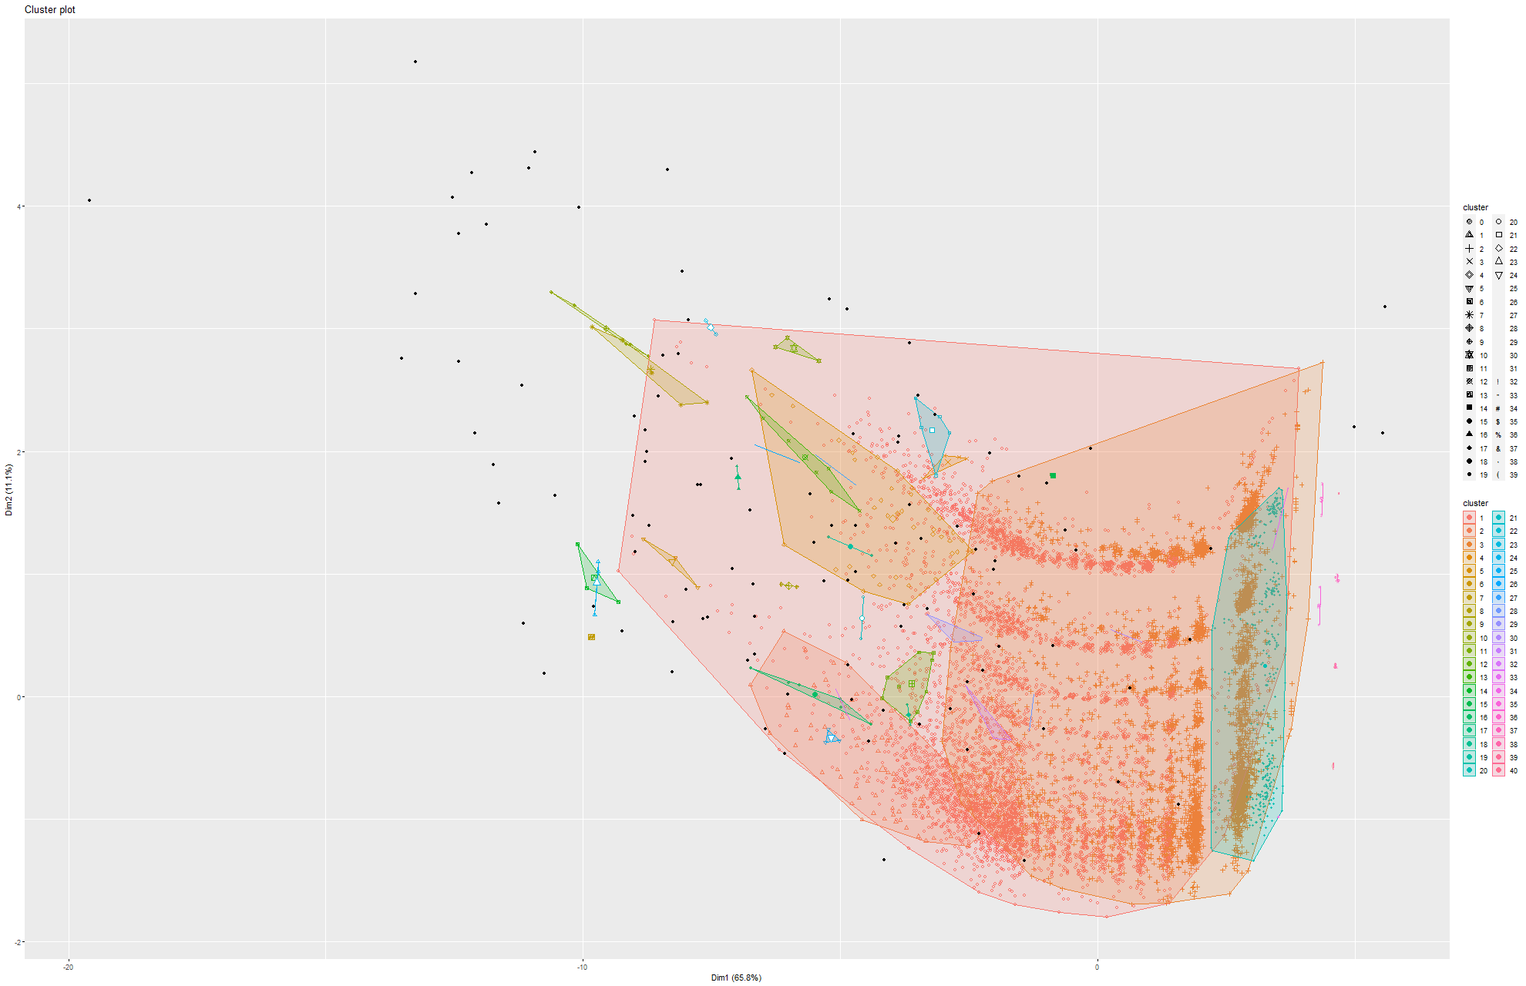
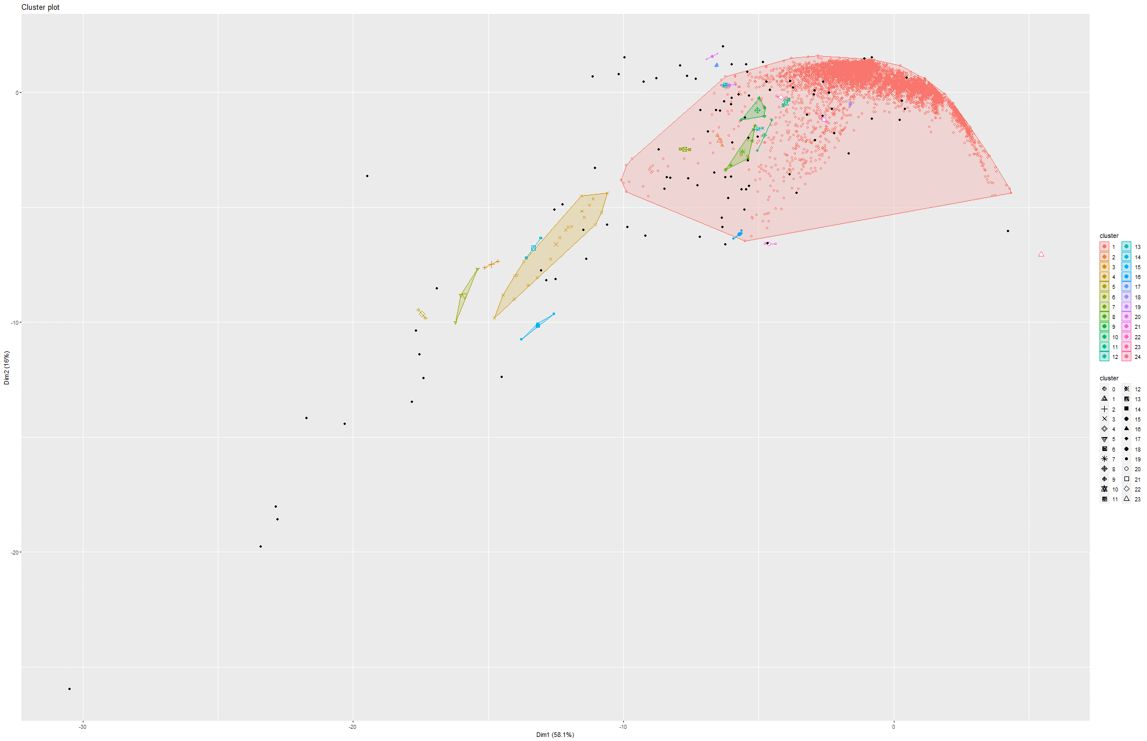
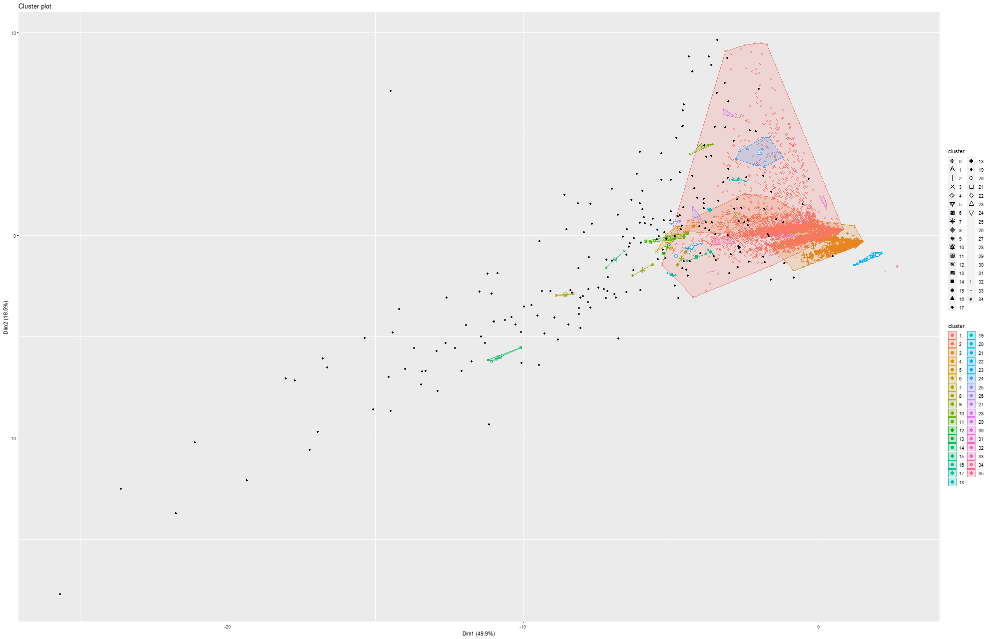
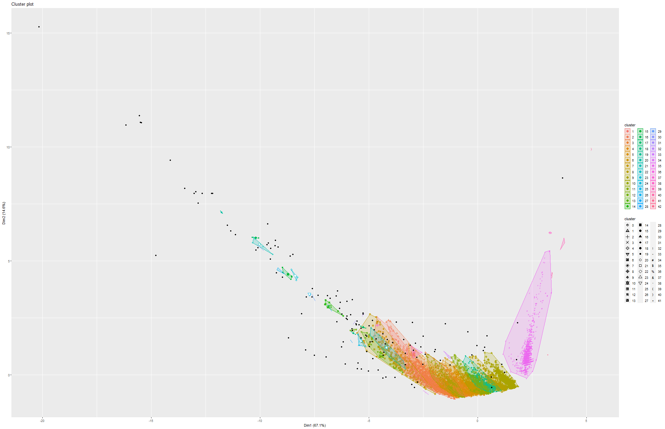
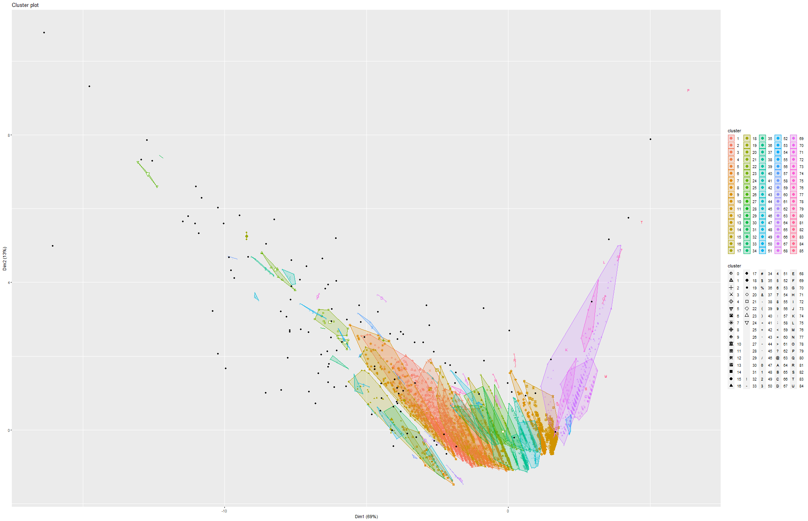
DBSCAN
PLOTS
Model 1
Model 2
Model 3
Model 4
Model 5
Model 6
Model 7
Model 8
Model 9

Slide 18
RESULTS
(on the ca-HepPH dataset)

Slide 19
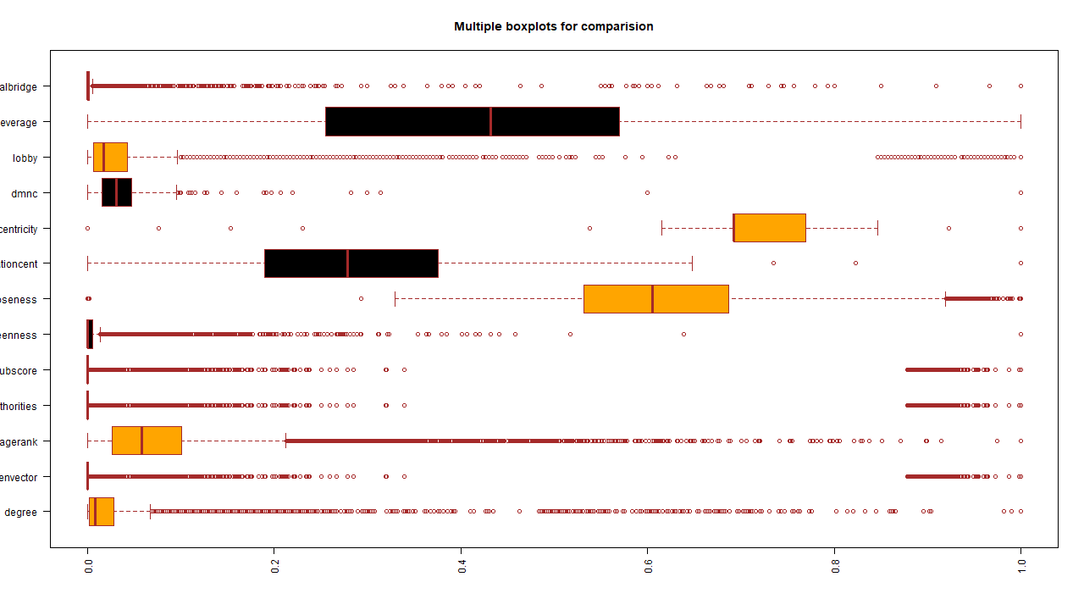
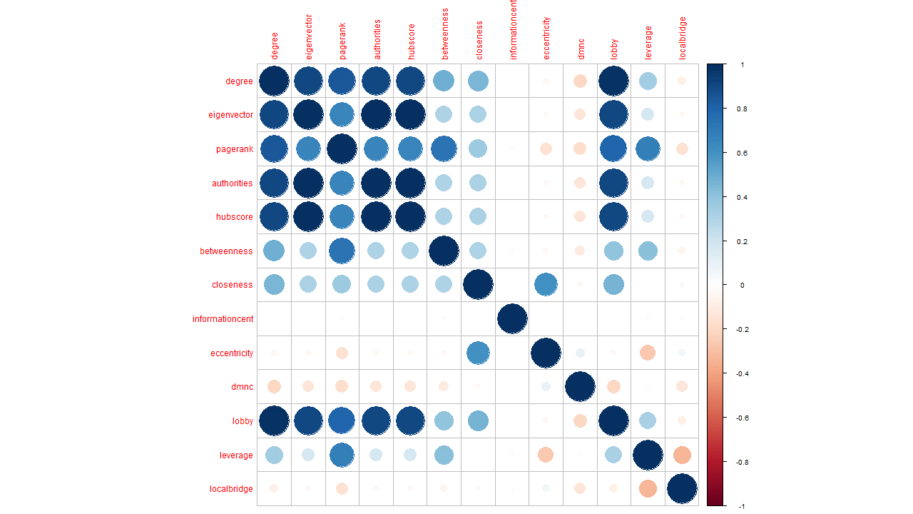
DATA
ANALYSIS
Boxplot
Correlation plot

Slide 20
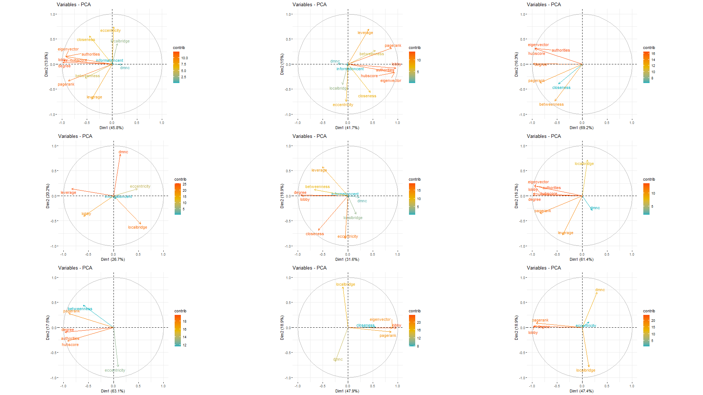
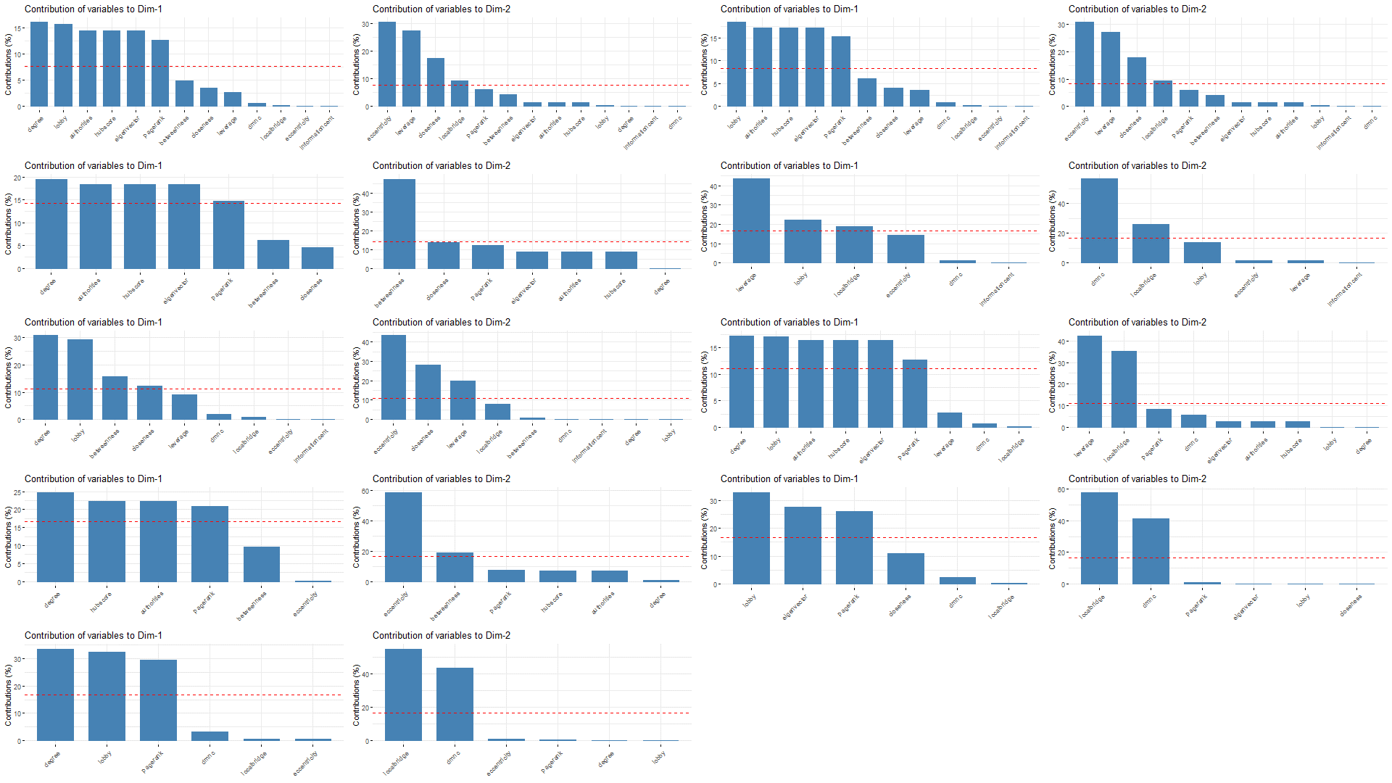
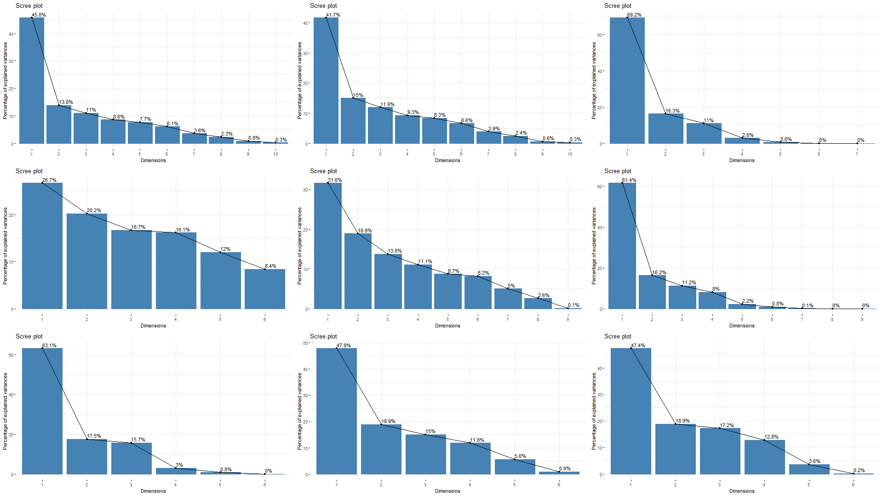

PCA
PLOTS
Cos2 Contribution
Dimension Contribution
Scree plot
Biplot

Slide 21









t-
S
N
E
P
L
O
T
S
(1st
M
O
D
E
L)
Model 1
Model 2
Model 3
Model 4
Model 5
Model 6
Model 7
Model 8
Model 9

Slide 22









UMAP
PLOTS
Model 1
Model 2
Model 3
Model 4
Model 5
Model 6
Model 7
Model 8
Model 9

Slide 23









SAMMON
MAP
PLOTS
Model 1
Model 2
Model 3
Model 4
Model 5
Model 6
Model 7
Model 8
Model 9

Slide 24









DBSCAN
PLOTS
Model 1
Model 2
Model 3
Model 4
Model 5
Model 6
Model 7
Model 8
Model 9

Slide 25
Conclusion
Based on our obtained results so far, we have found discriminatory visual aspects of different networks
Working on bigger datasets is extremely resource intensive, so that is a limitation we have faced
Hopefully we will have all the results within 2 weeks.

Slide 26
[1] Department of Physics Department of Electrical and Computer Engineering. (2012). Review Literature And Arts Of The Americas, 3977–3980.
[2] Dwyer, T., Kosch, D., & Xu, K. (2003). Visual Analysis of Network Centralities. Wuchty 2002.
[3] De La Peña Sarracén, G. L., & Rosso, P. (2018). Automatic text summarization based on betweenness centrality. ACM International Conference Proceeding Series, Part F1377. https://doi.org/10.1145/3230599.3230611
[4] Wu, Q., Qi, X., Fuller, E., & Zhang, C. Q. (2013). “follow the leader”: A centrality guided clustering and its application to social network analysis. The Scientific World Journal, 2013. https://doi.org/10.1155/2013/368568
[5] Huang, X., Zhao, Y., Yang, J., Zhang, C., & Ye, X. (2016). TrajGraph : A Graph-Based Visual Analytics Approach to Studying Urban Network Centralities Using Taxi Trajectory Data. 22(1), 160–169.
[6] Crucitti, P., Latora, V., & Porta, S. (2006). Centrality measures in spatial networks of urban streets. Physical Review E - Statistical, Nonlinear, and Soft Matter Physics, 73(3), 1–5. https://doi.org/10.1103/PhysRevE.73.036125
[7] Zhang, Y., Wang, X., Zeng, P., & Chen, X. (2011). Centrality characteristics of road network patterns of traffic analysis zones. Transportation Research Record, 2256, 16–24. https://doi.org/10.3141/2256-03

